Slide 1
Custom textures reconstruction

Slide 2
Custom textures
vaults’ textures (2)
arcs’ textures (4)
walls’ textures (7)
other elements’ textures (2)
columns’ textures (6)
windows’ textures (3)
doors’ textures (2)
fabrics’ textures (3)

Slide 3
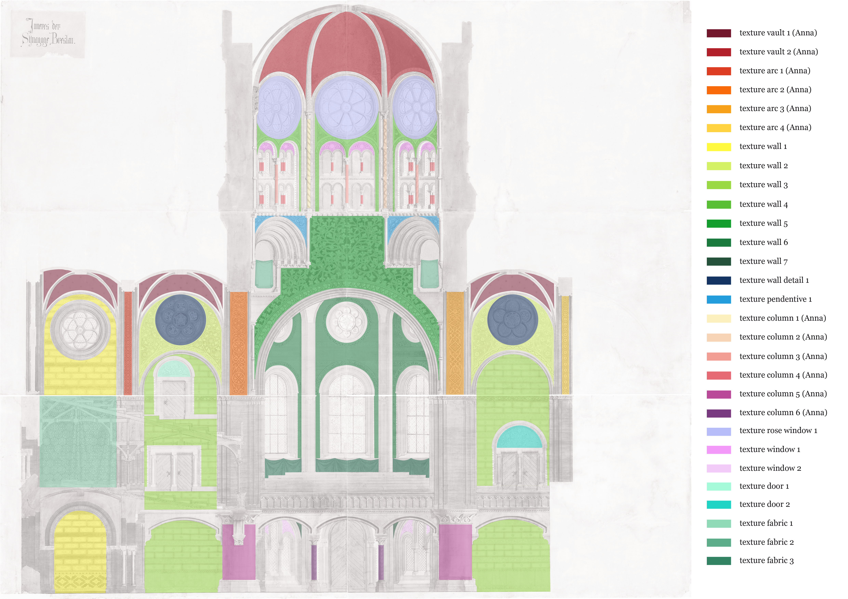
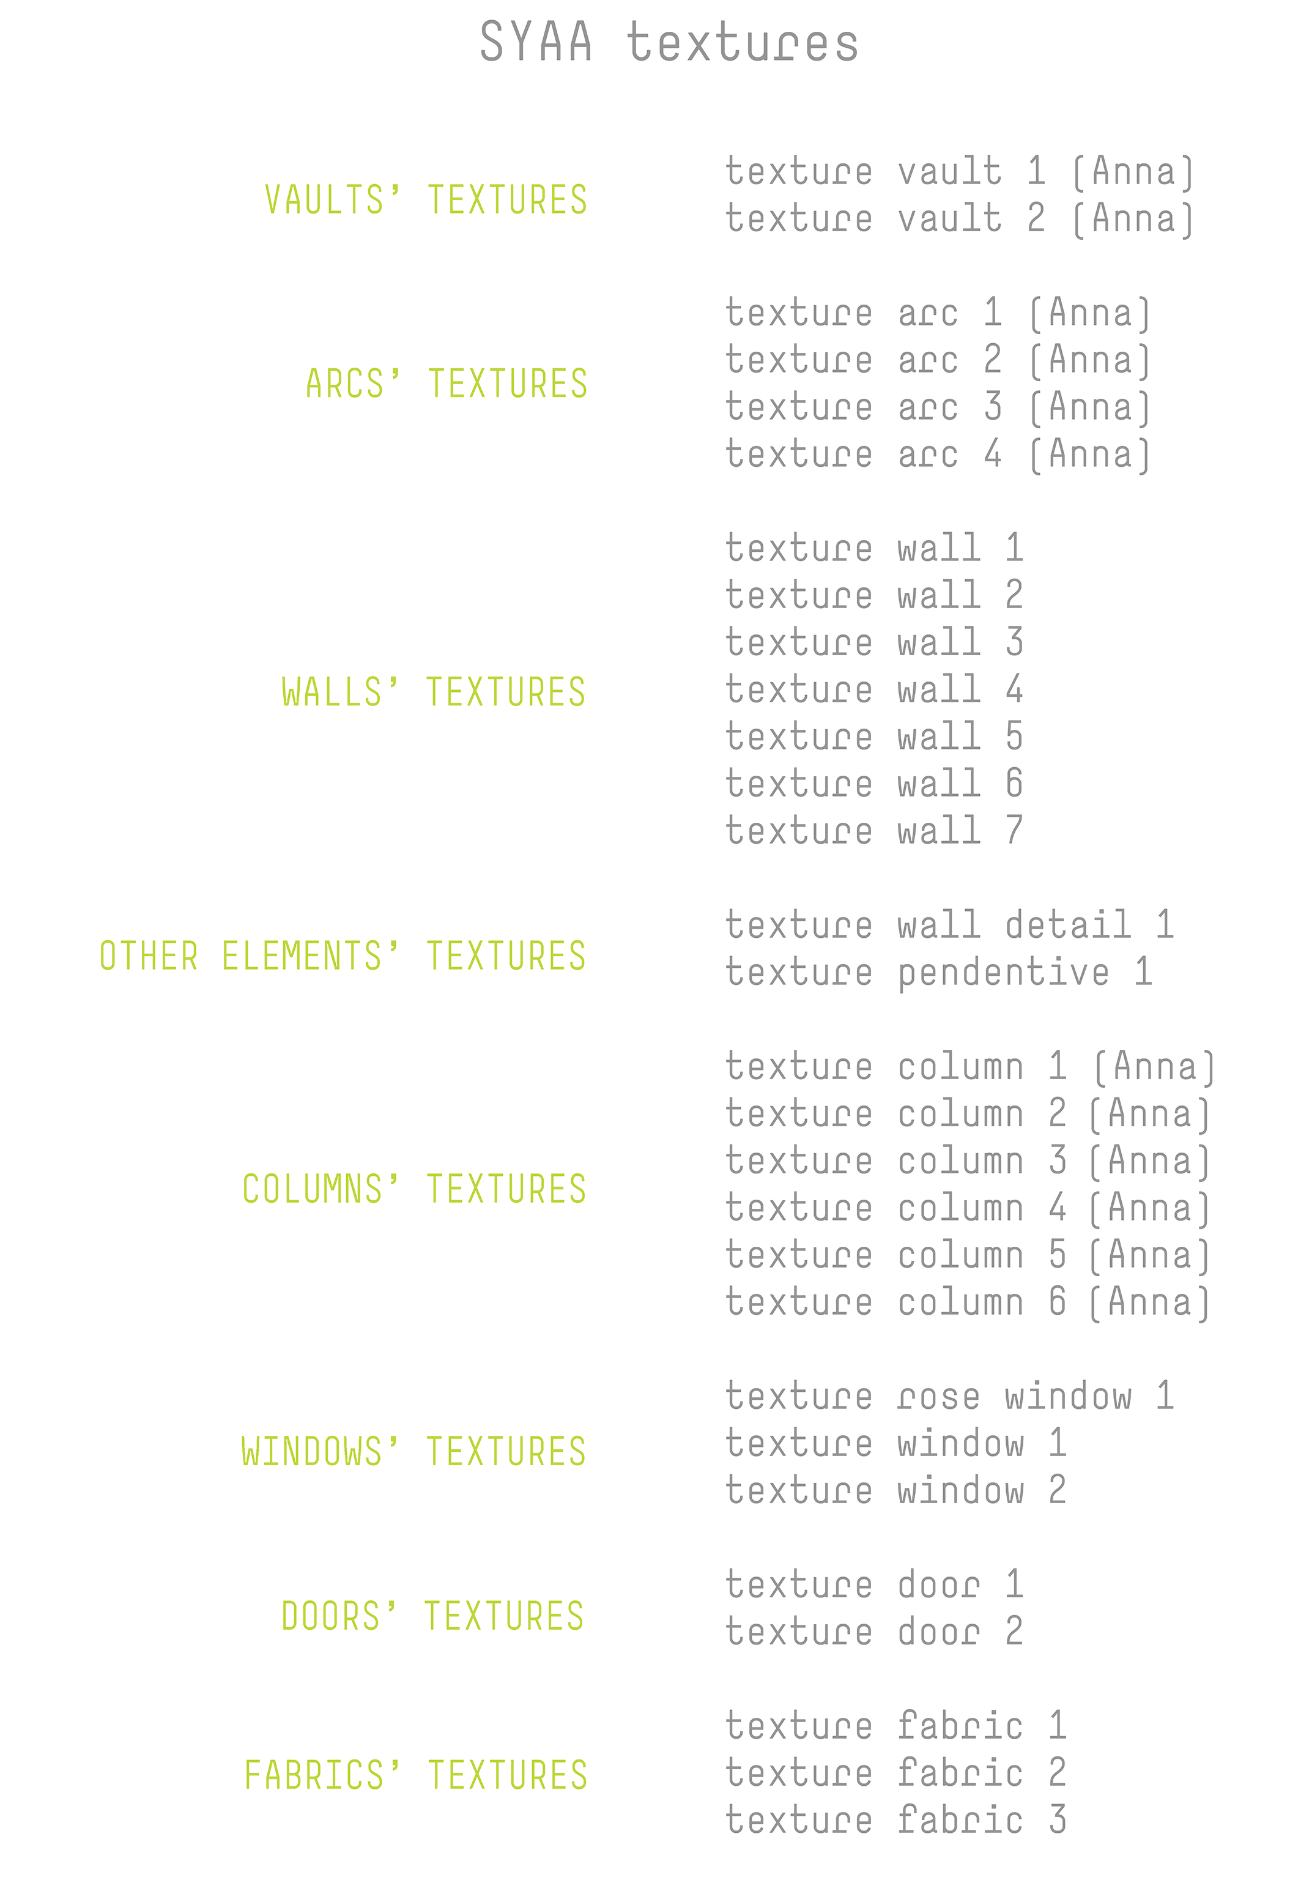
Custom textures
Division

Slide 4
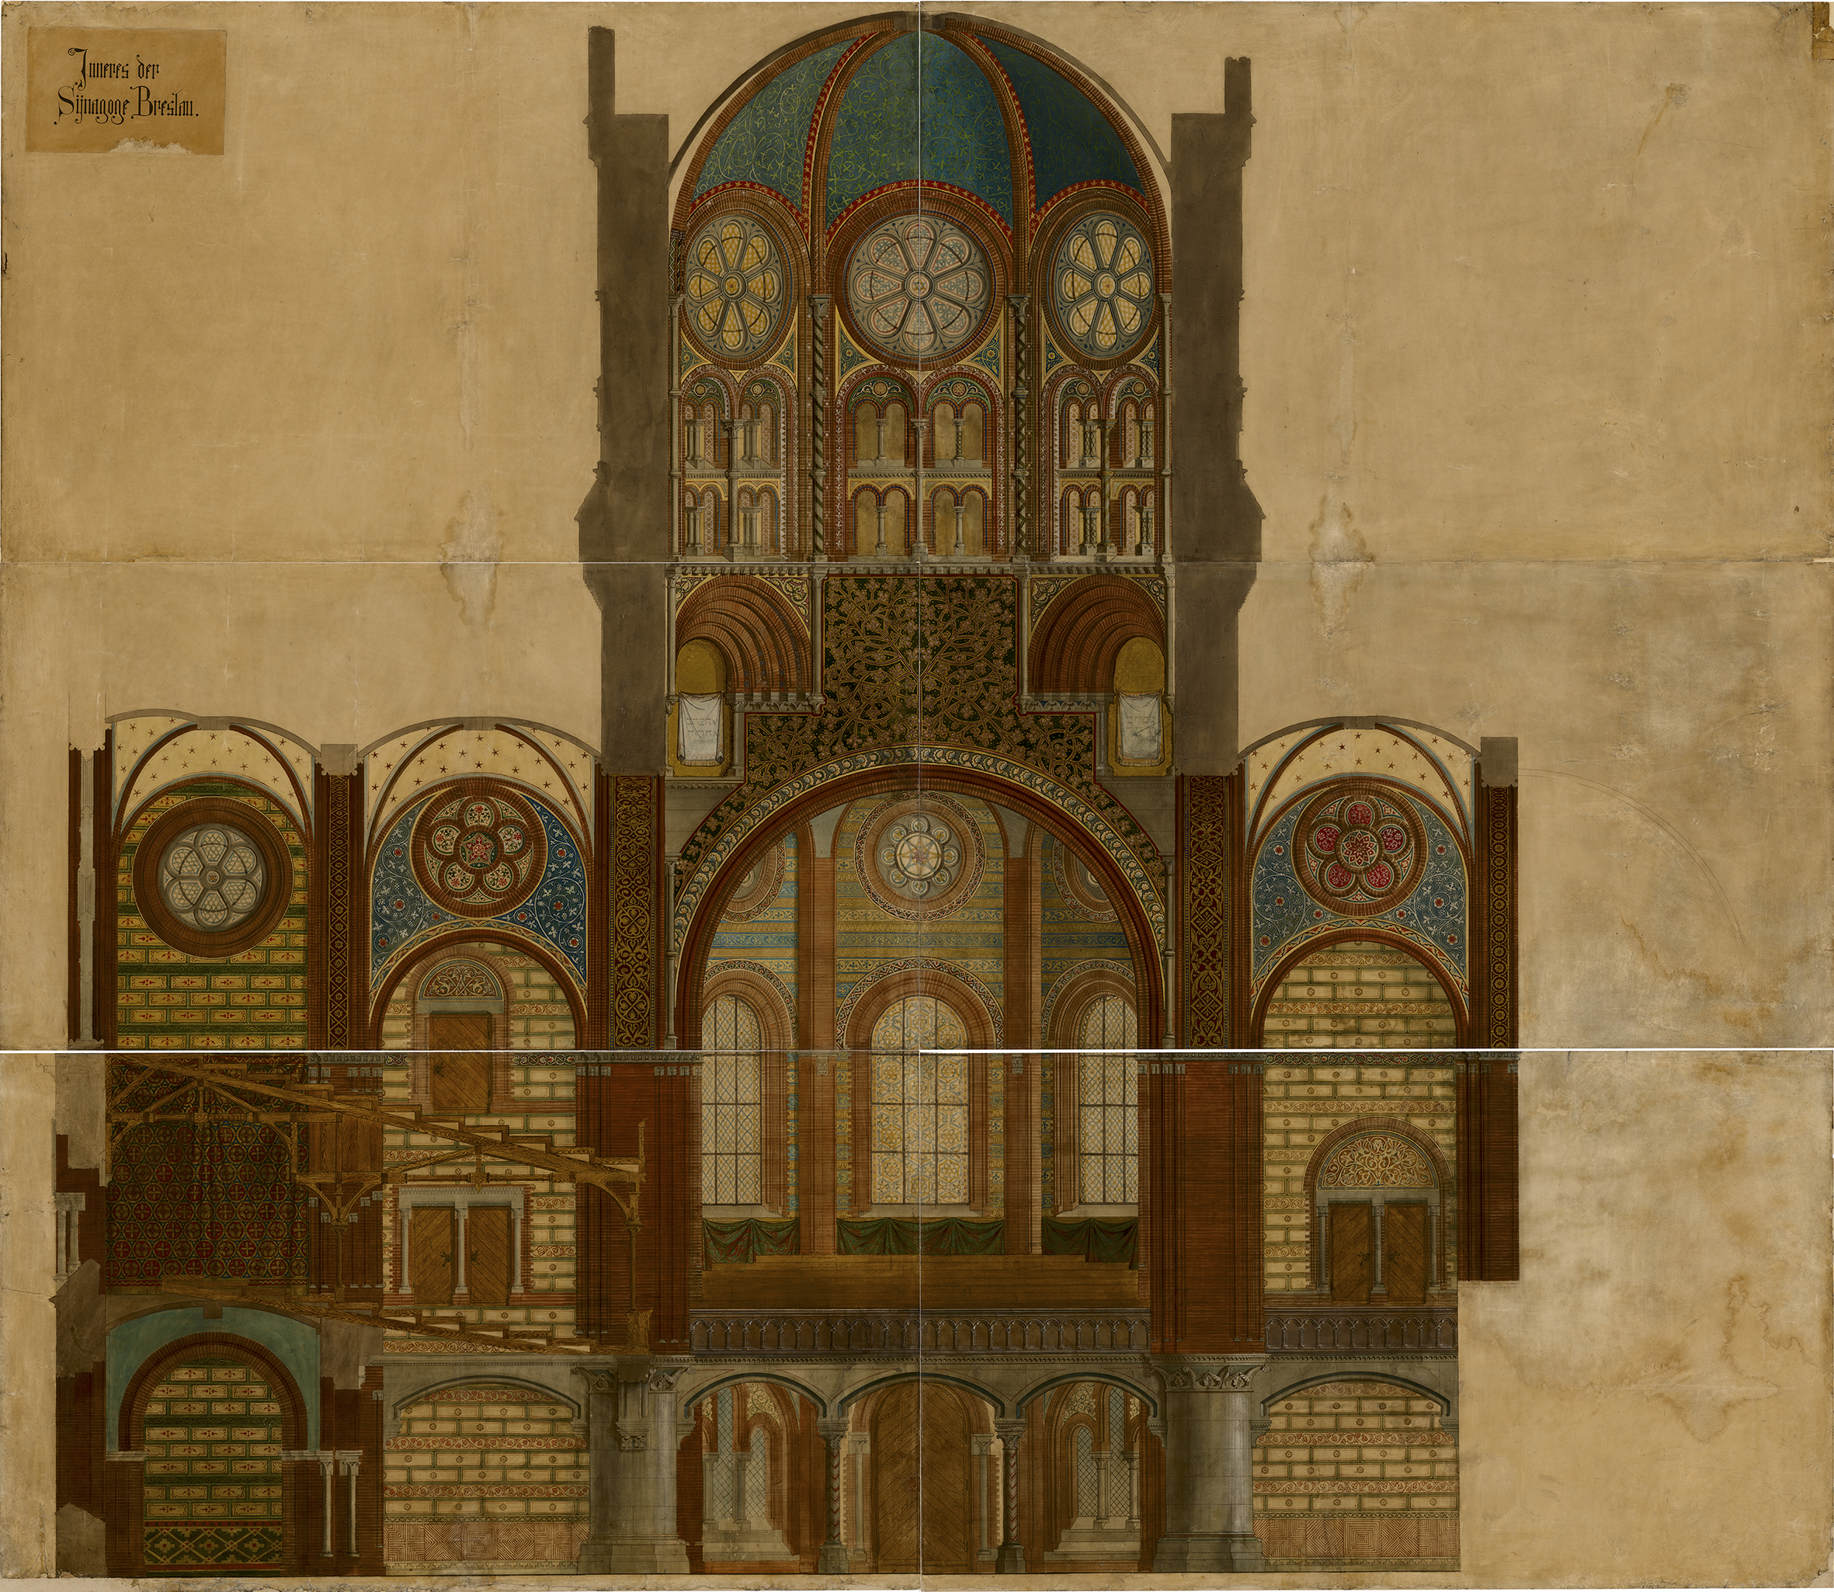
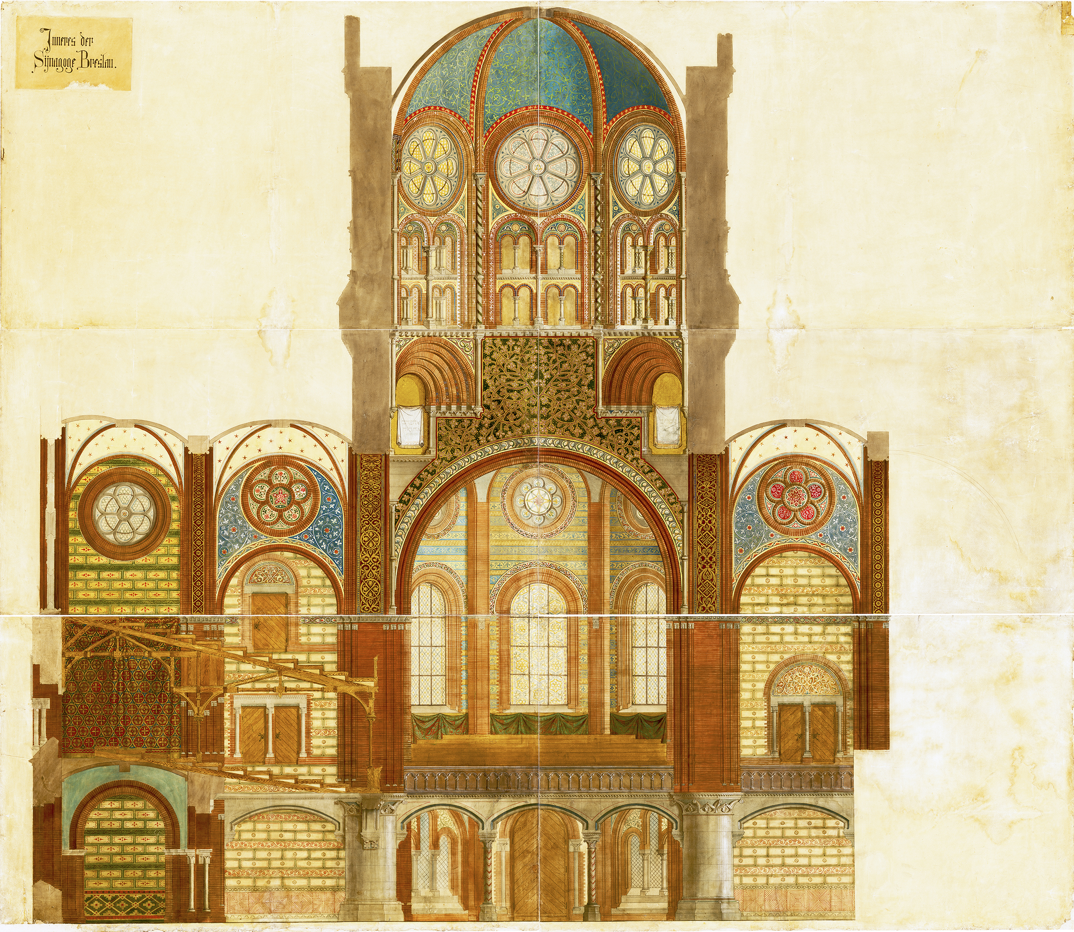
Colours of the source
Brightening and removing yellow tint from the original drawing
original drawing
drawing with changed colours
source: longitudinal section in colour from Stadtarchiv Hannover

Slide 5
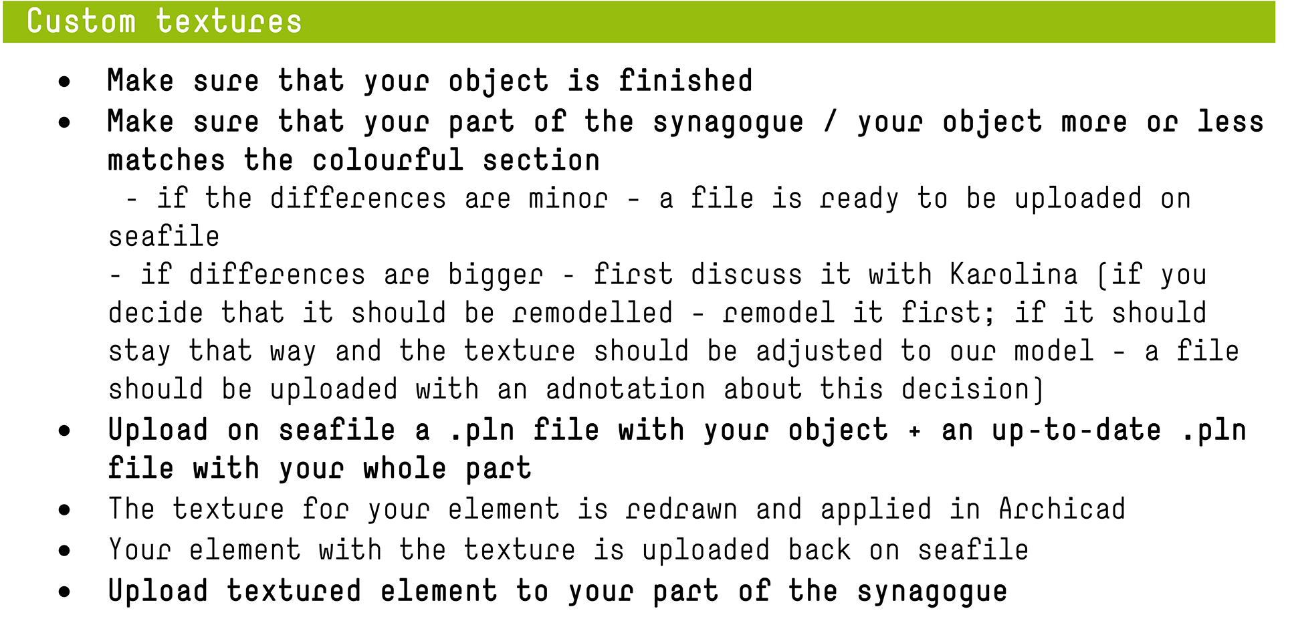
Custom textures - workflow pdf with workflow uploaded on seafile
Problem with working with custom textures right now – most of the textures from colourful section are from CPMP (part of Igor, who doesn’t work right now); there is no cooperation between modeller and a person who creates textures, encountered mistakes cannot be corrected etc.

Slide 6
Adjusting the drawing (source of textures) and the model

Slide 7
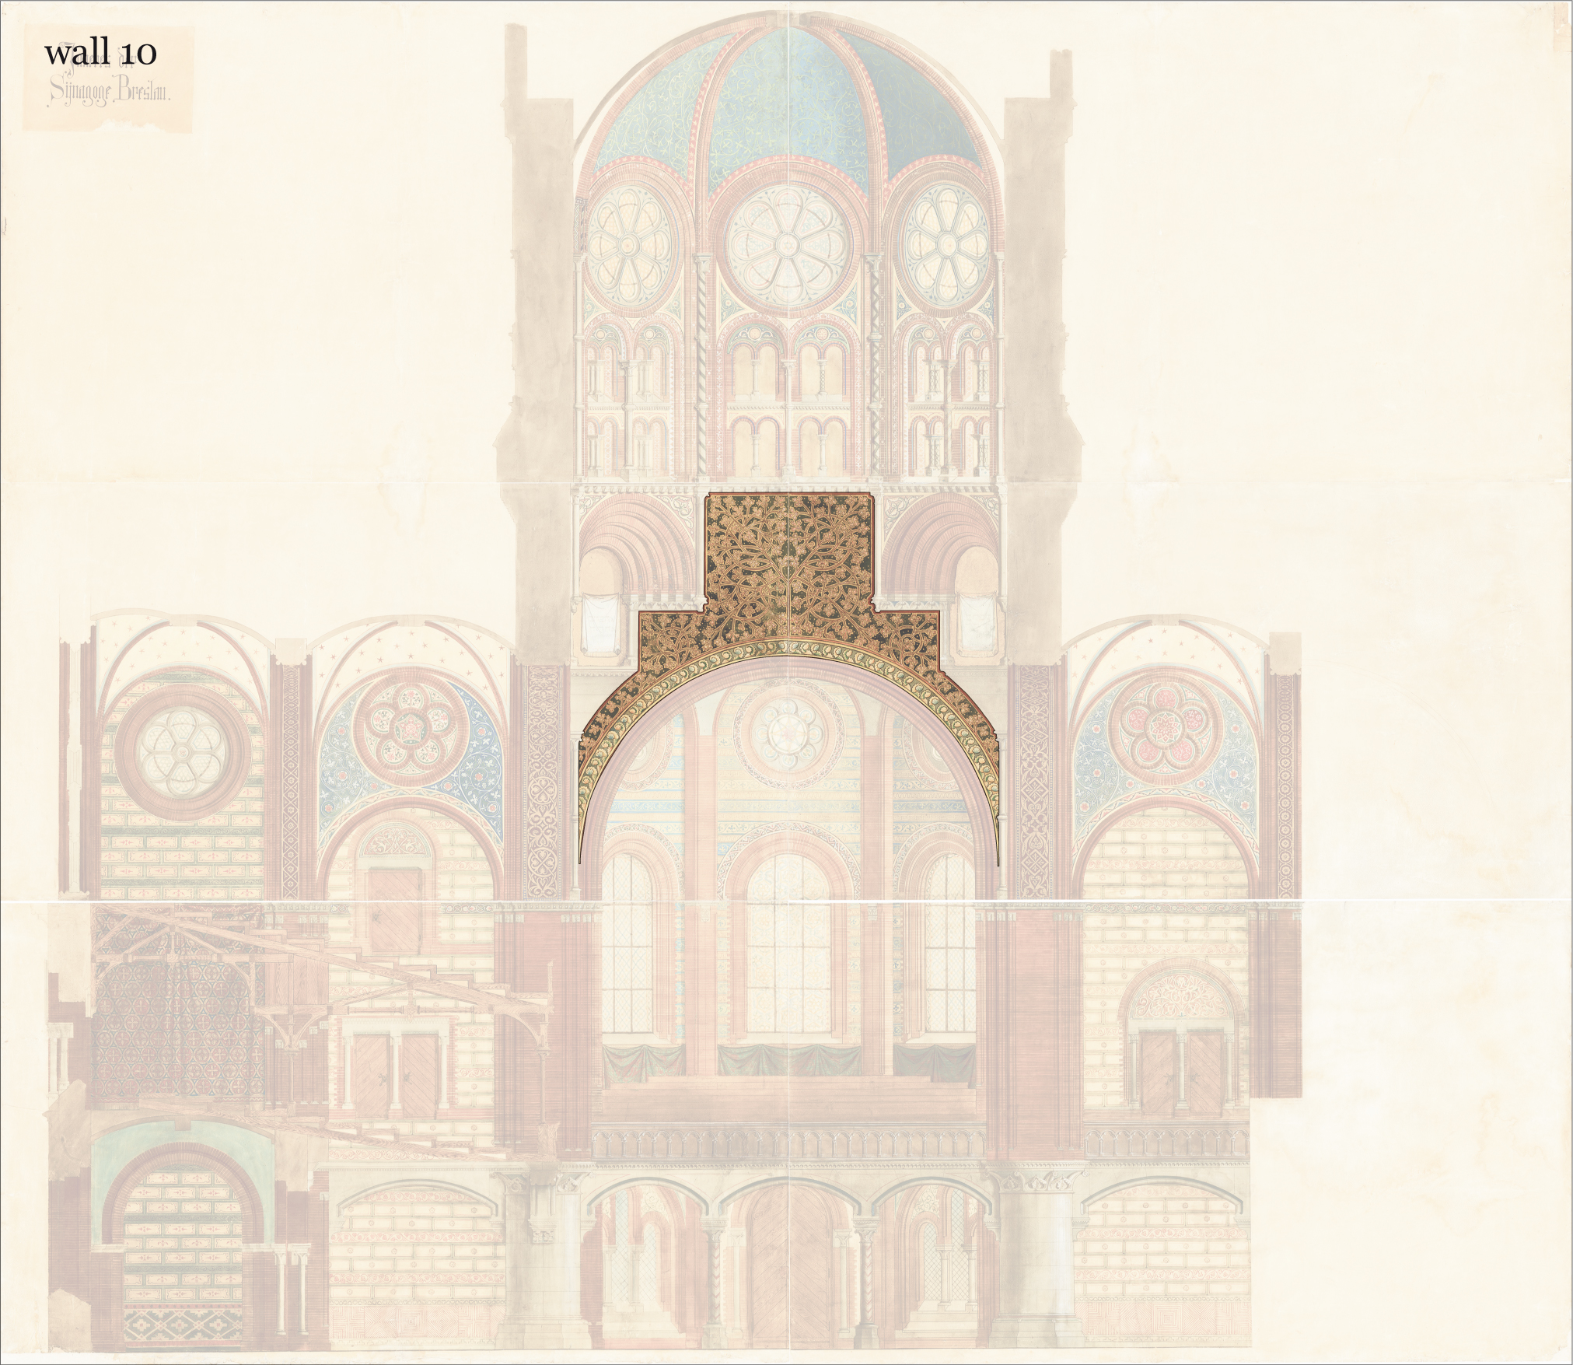
Choosing a sample wall texture in CPMP

Slide 8
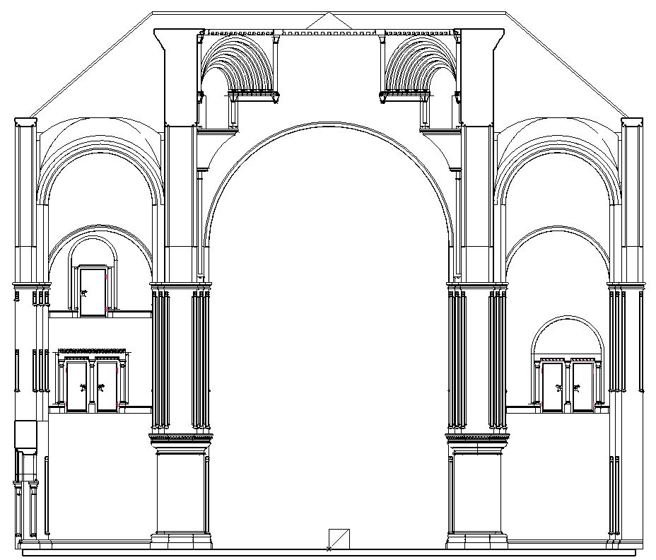
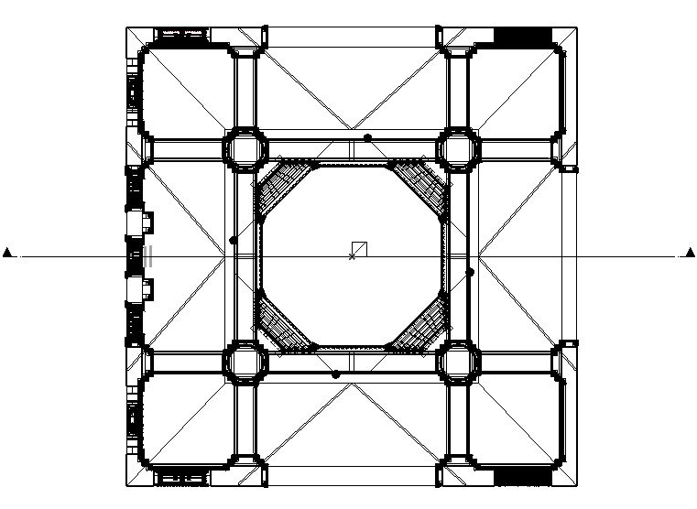
First step exporting a section of CPMP model from Archicad
aim: to confront the real dimensions and shape (in model) of the element that is supposed to be textured with the dimensions of the element on the source (colourful section from Hannover)

Slide 9
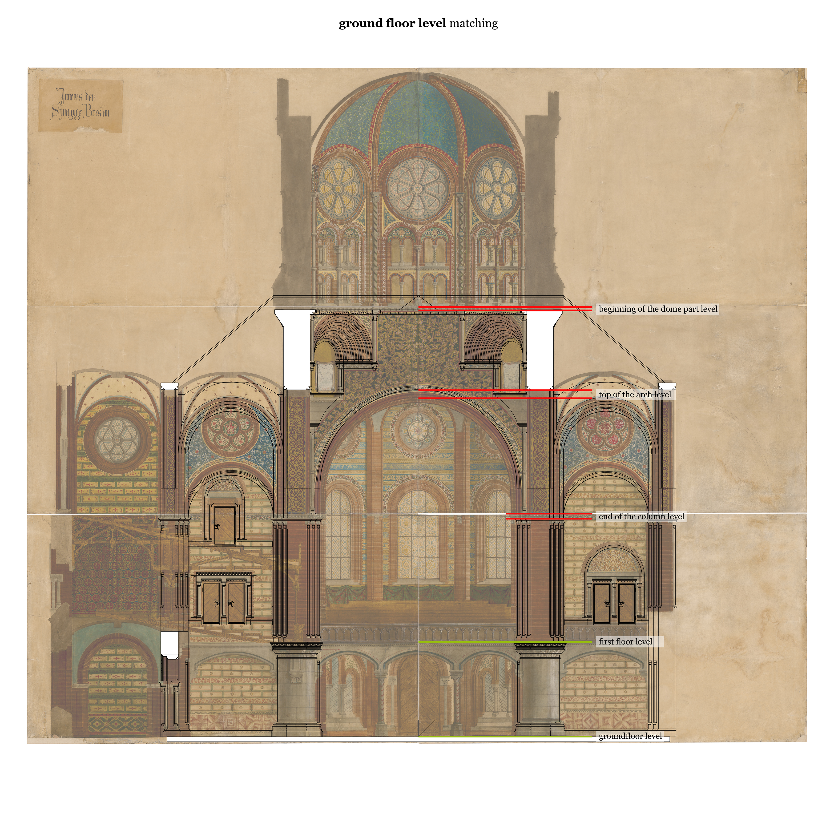
Second step fitting section from model with colourful section (source for texturing)

Slide 10
Second step fitting section from model with colourful section (source for texturing)
sections were fitted to each other starting from groundfloor level
problem: section from model and colourful section doesn’t exactly fit; chosen element (to texturize) has other geometry in model than in colourful section

Slide 11
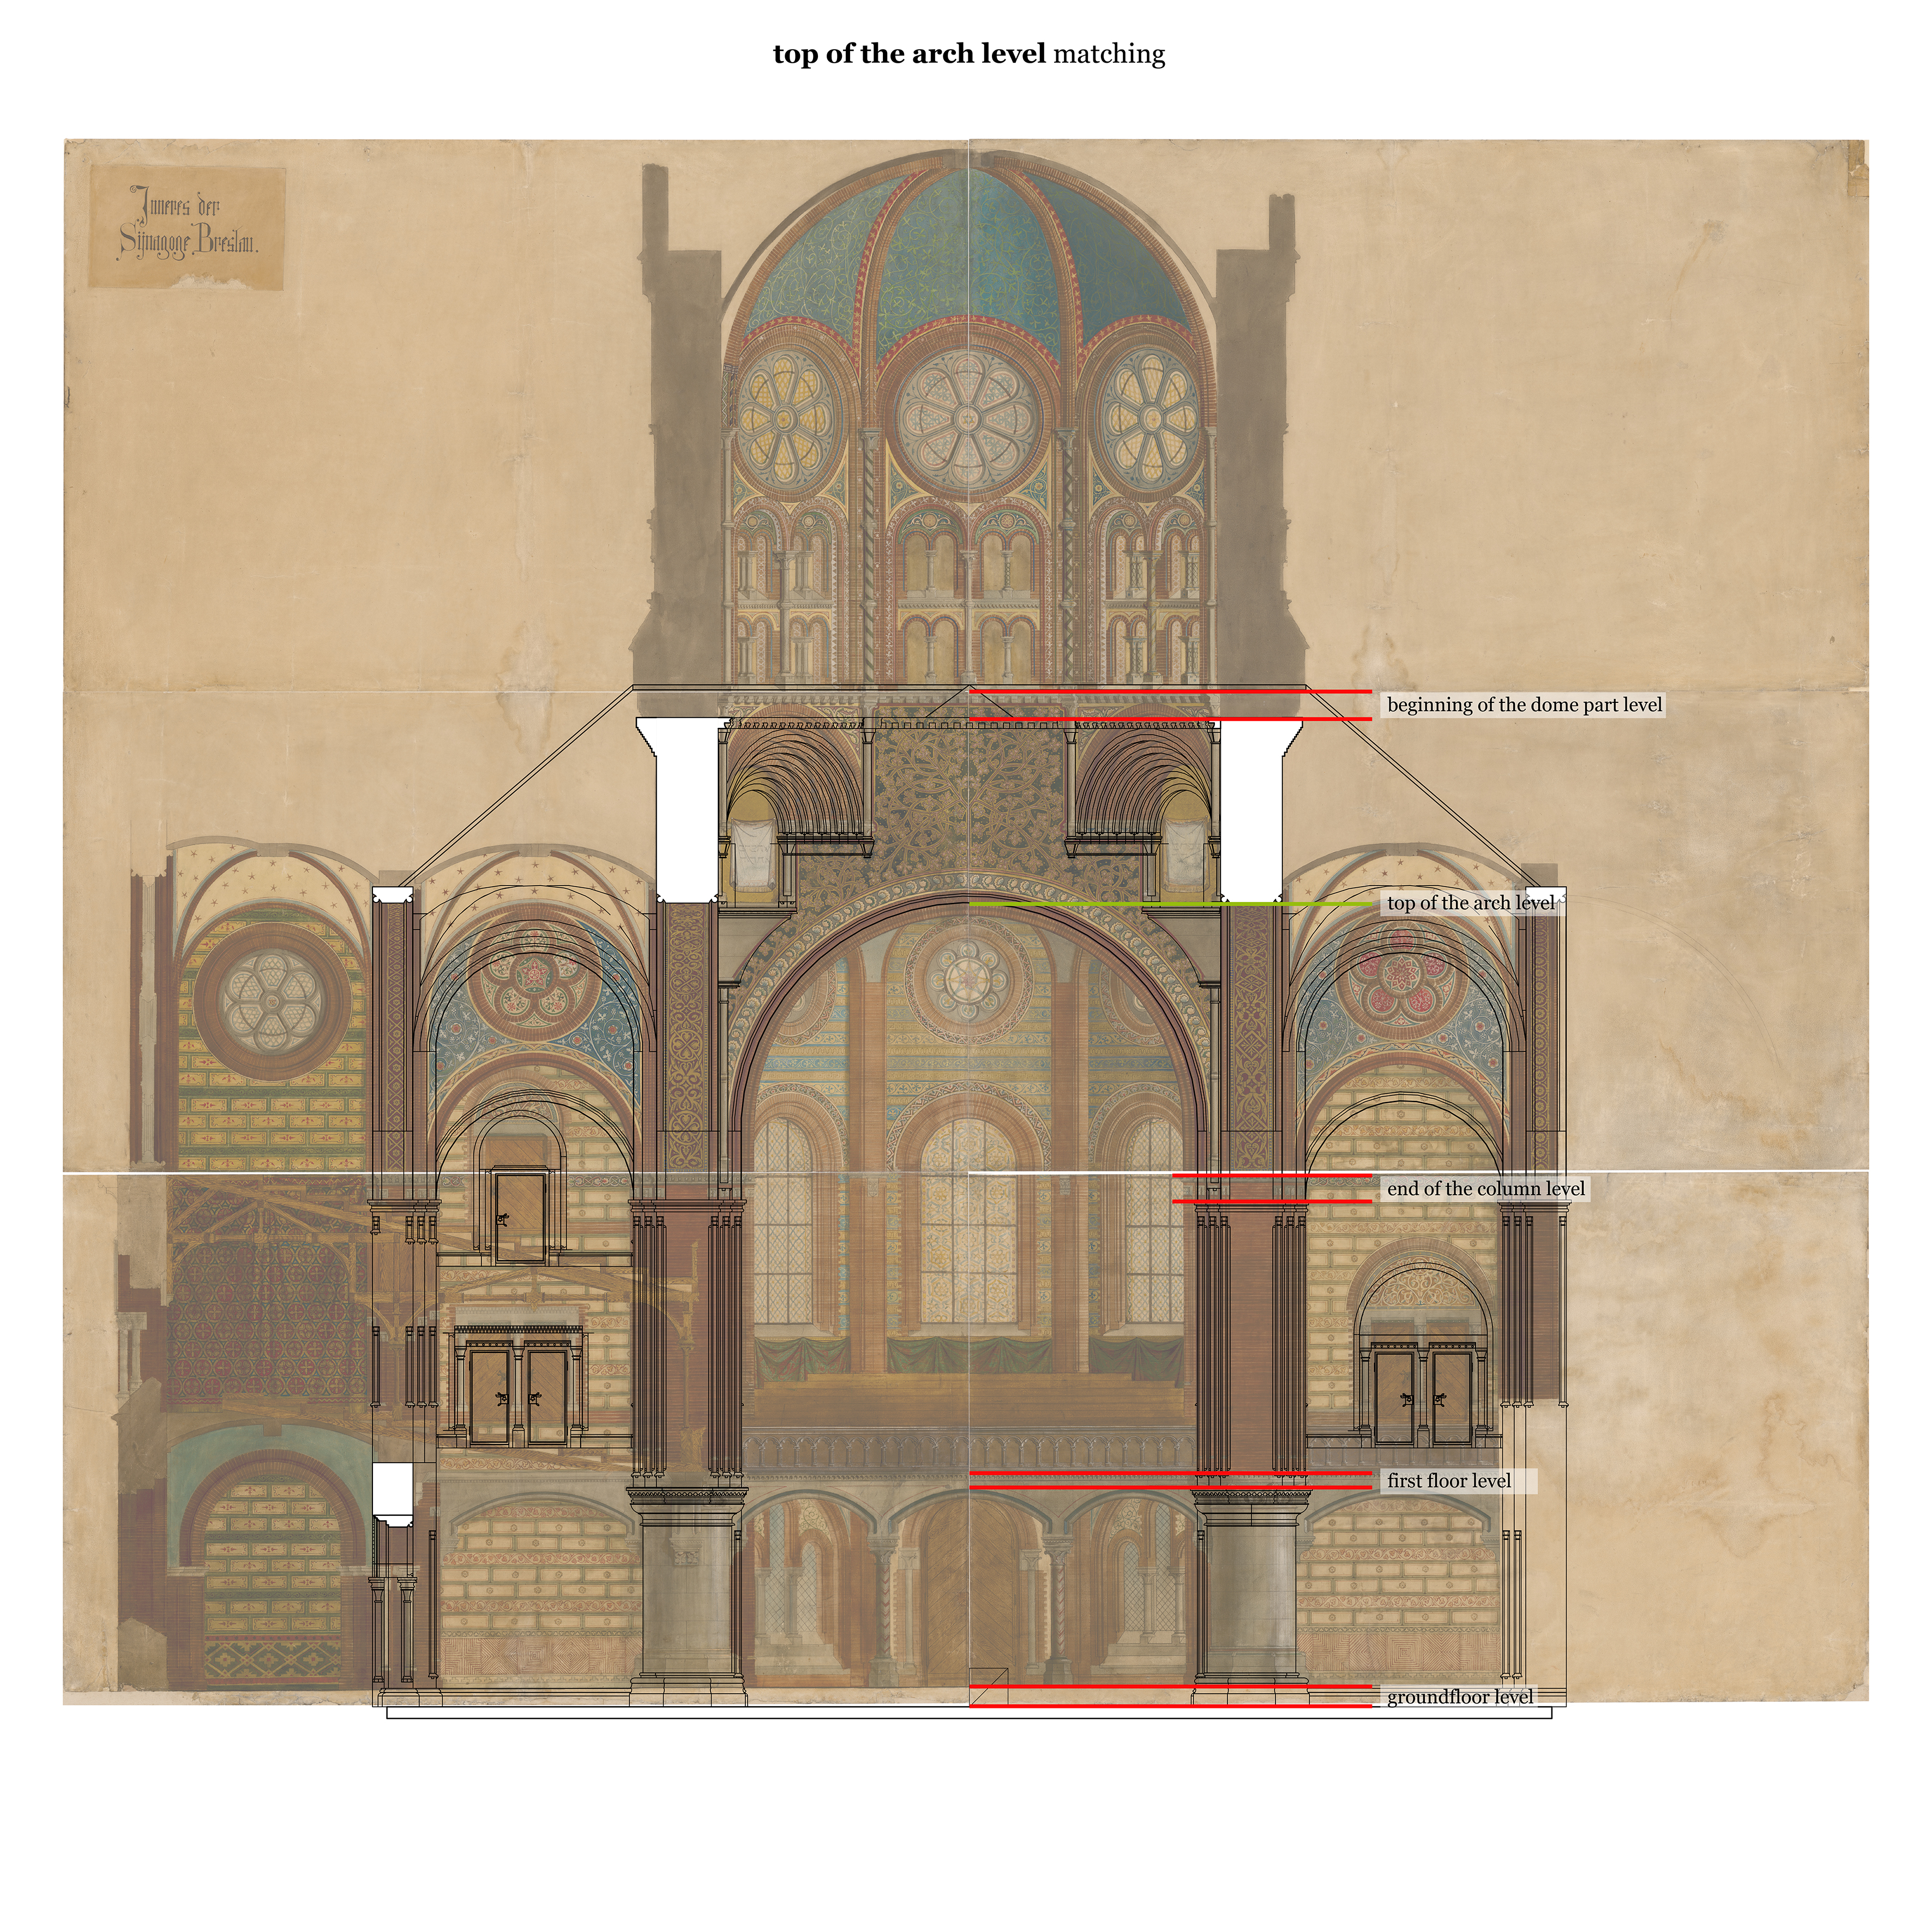
Second step fitting section from model with colourful section (source for texturing) no2

Slide 12
Second step fitting section from model with colourful section (source for texturing) no2
sections were fitted to each other starting from top of the arch level in order to fit only the element chosen to texturize, not the whole section
problem: still sections doesn’t fit, chosen element is much shorter in model than in colourful section

Slide 13
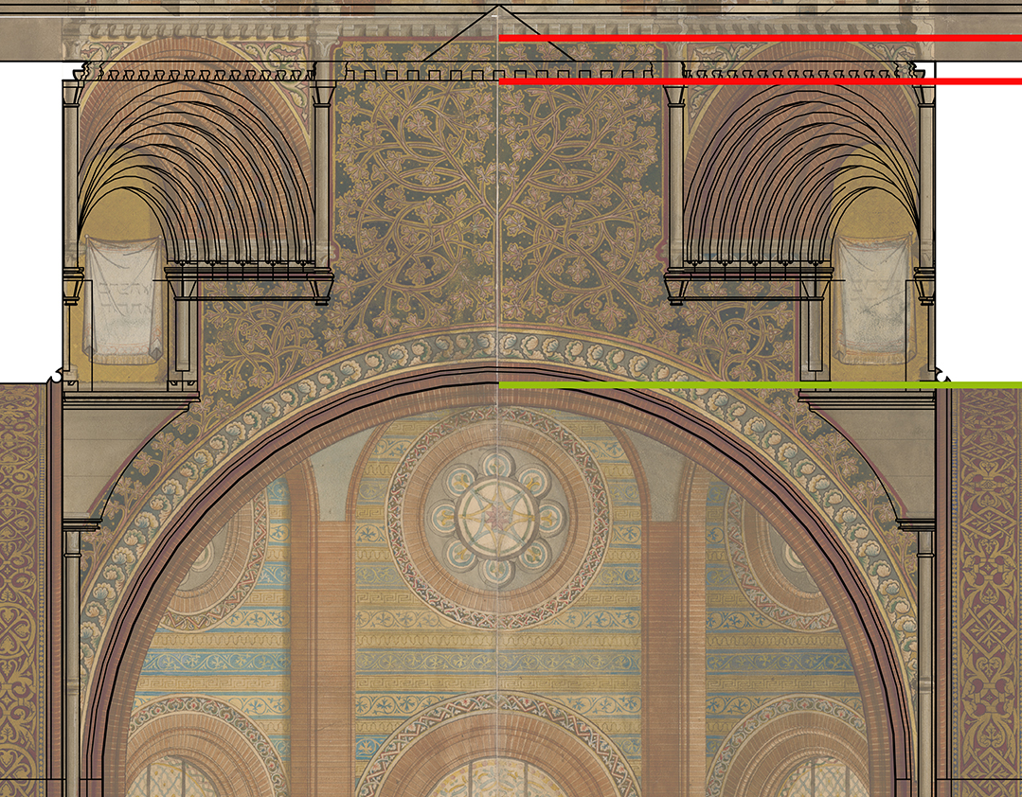
Problem how to make a texture for the element that doesn’t exactly fit?
Possible solutions:
- cutting off part of the texture from the colourful section
(not the whole texture is on the element, but it is in correct proportions)
- changing the proportions of the texture
(the whole texture is on the element, but proportions are different)
- changing the geometry of the model
(the best for texturizing aspect but time-consuming and can cause confusion)
The problem will be probably repeated with many elements as model and section doesn’t exactly fit to each other (differents in heights, differents in exact geometry etc.)

Slide 14
Solution no1 cutting off part of the texture from the colourful section
This solution seems to be the quickest and the easiest to make, but the result is that the exact appearance of the element wouldn’t be illustrated in the final model.
When a part of the texture is cut off, its composition is destroyed – e.g. in this case we cut off the ending of the floral pattern and in our texturized element in model the branches wouldn’t end with flowers, as it is on the original texture.
This solution lets present the main idea of the texture, the type of the pattern and colour scheme but is not the exact reflection of the texture presented in colourful section.

Slide 15
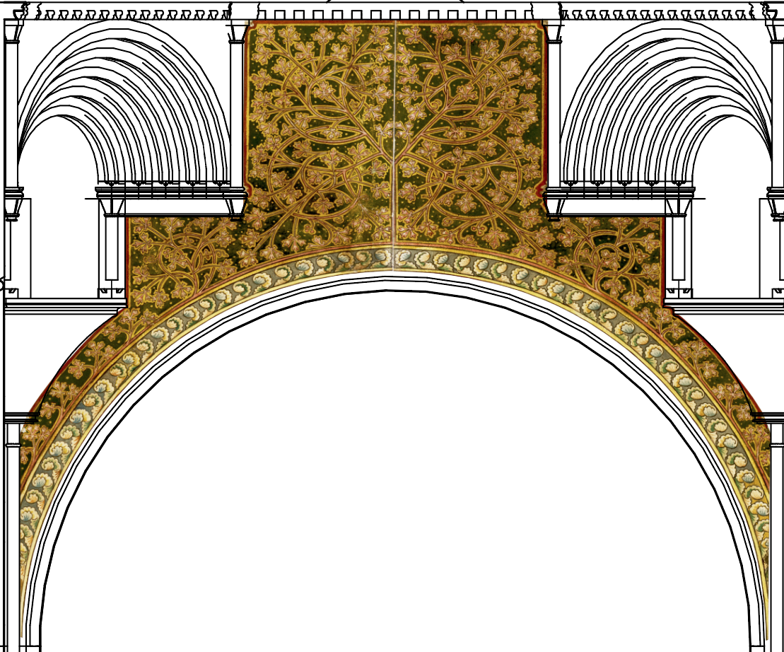
Solution no2 changing the proportion of the texture
This solution needs warping the original texture (fragment of the colourful section) in Photoshop to adjust it to the size and proportions of modelled element.
This solution lets present the original composition, but size and proportions of the elements of the texture are different.

Slide 16
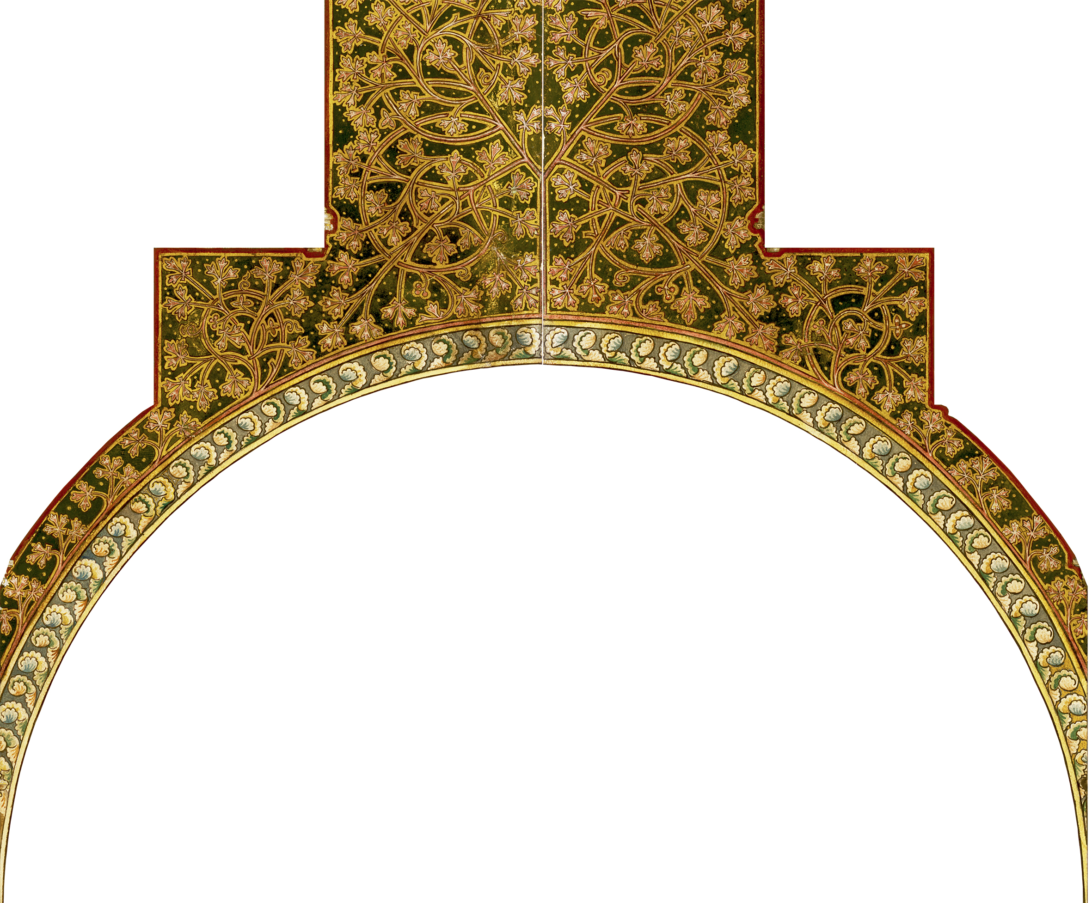
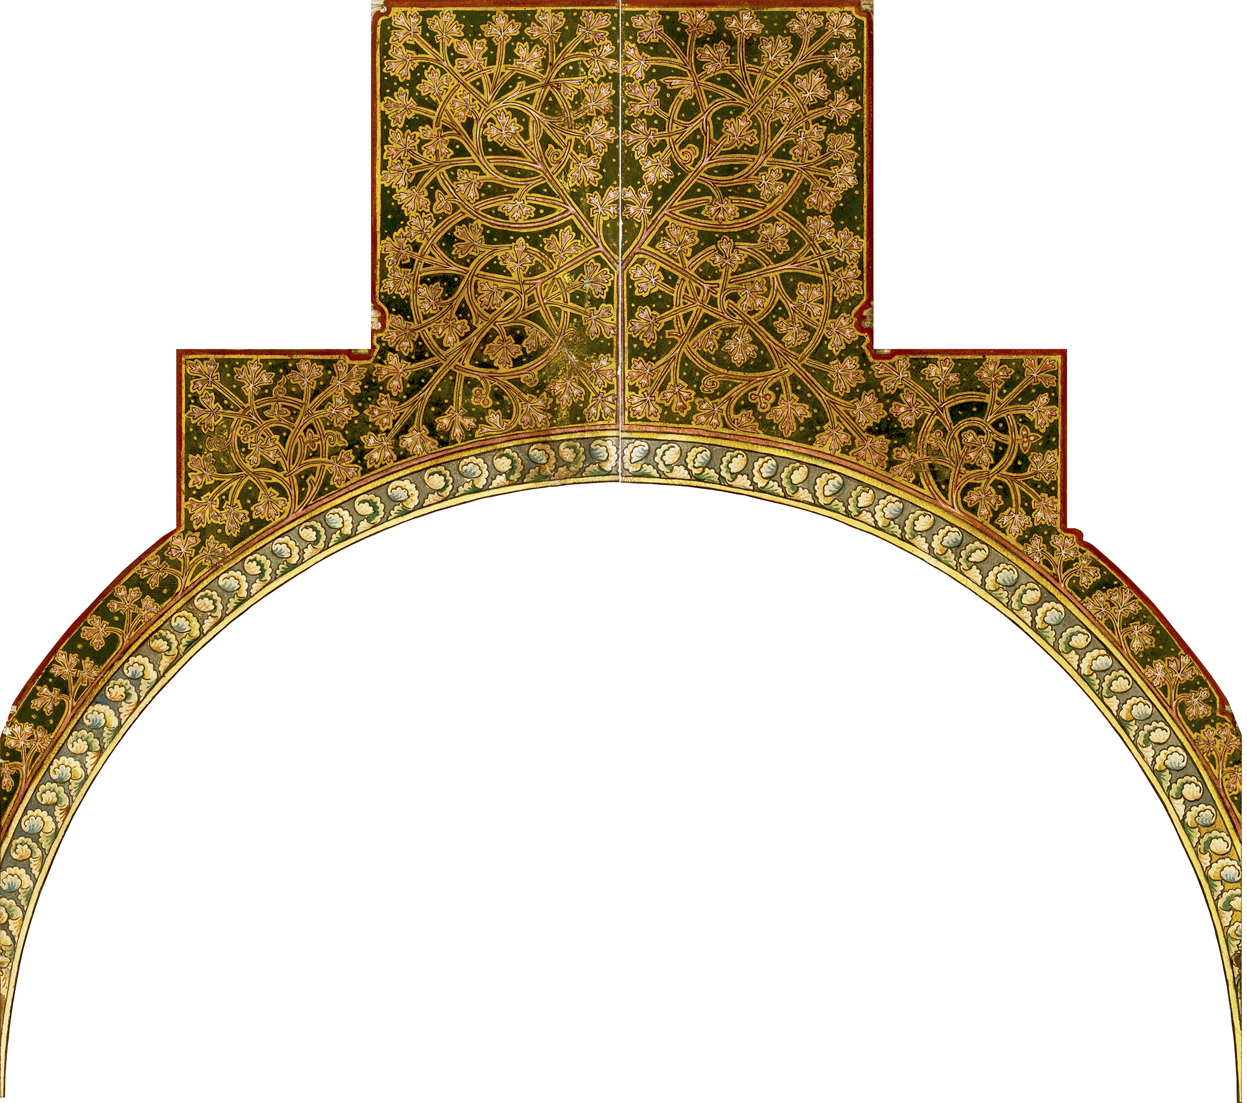
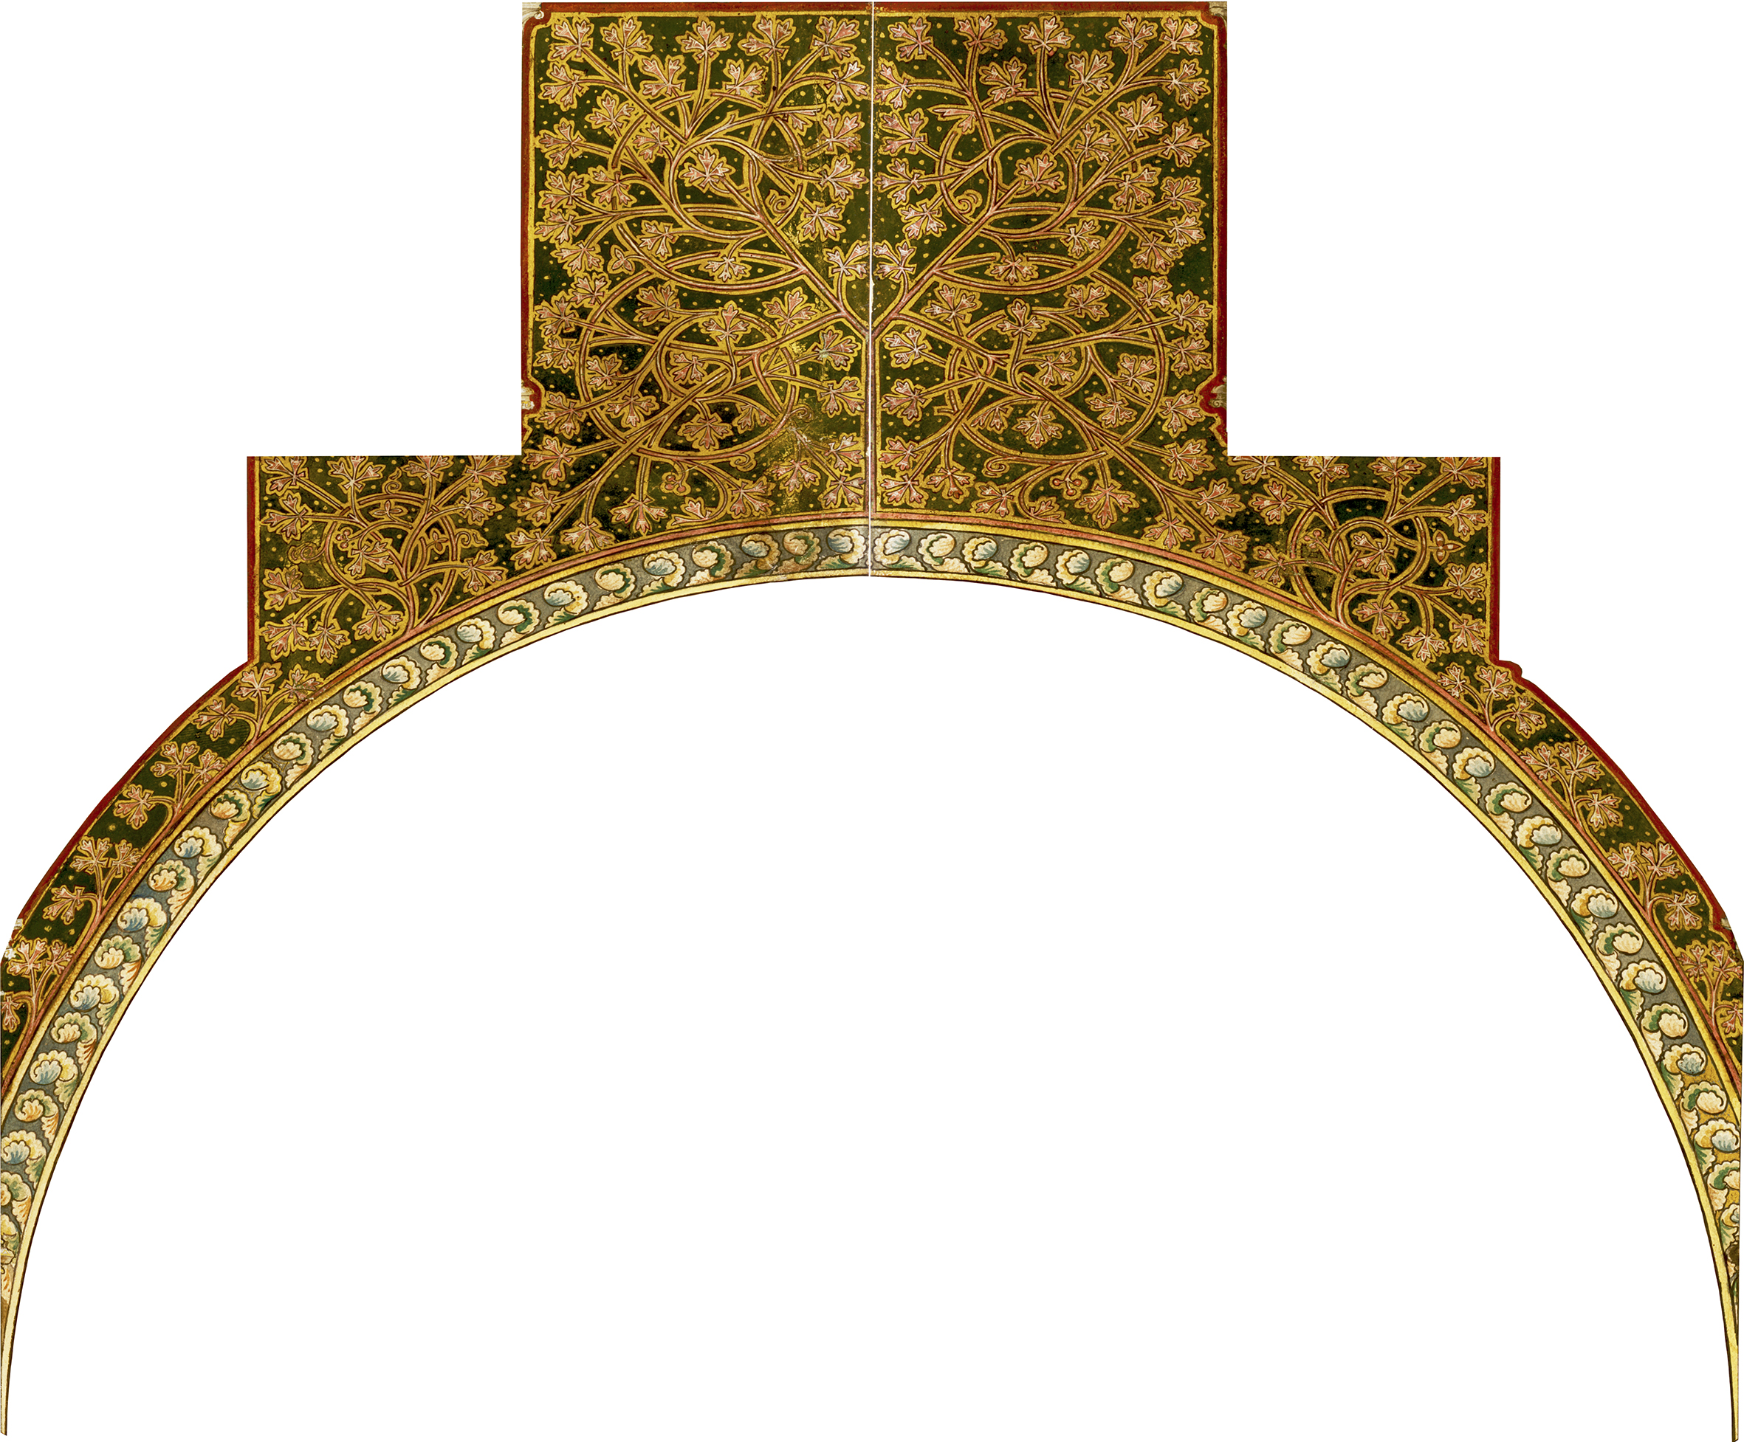
Solution no2 comparison of the original and the texture with changed proportions
original texture
texture with changed proportions

Slide 17
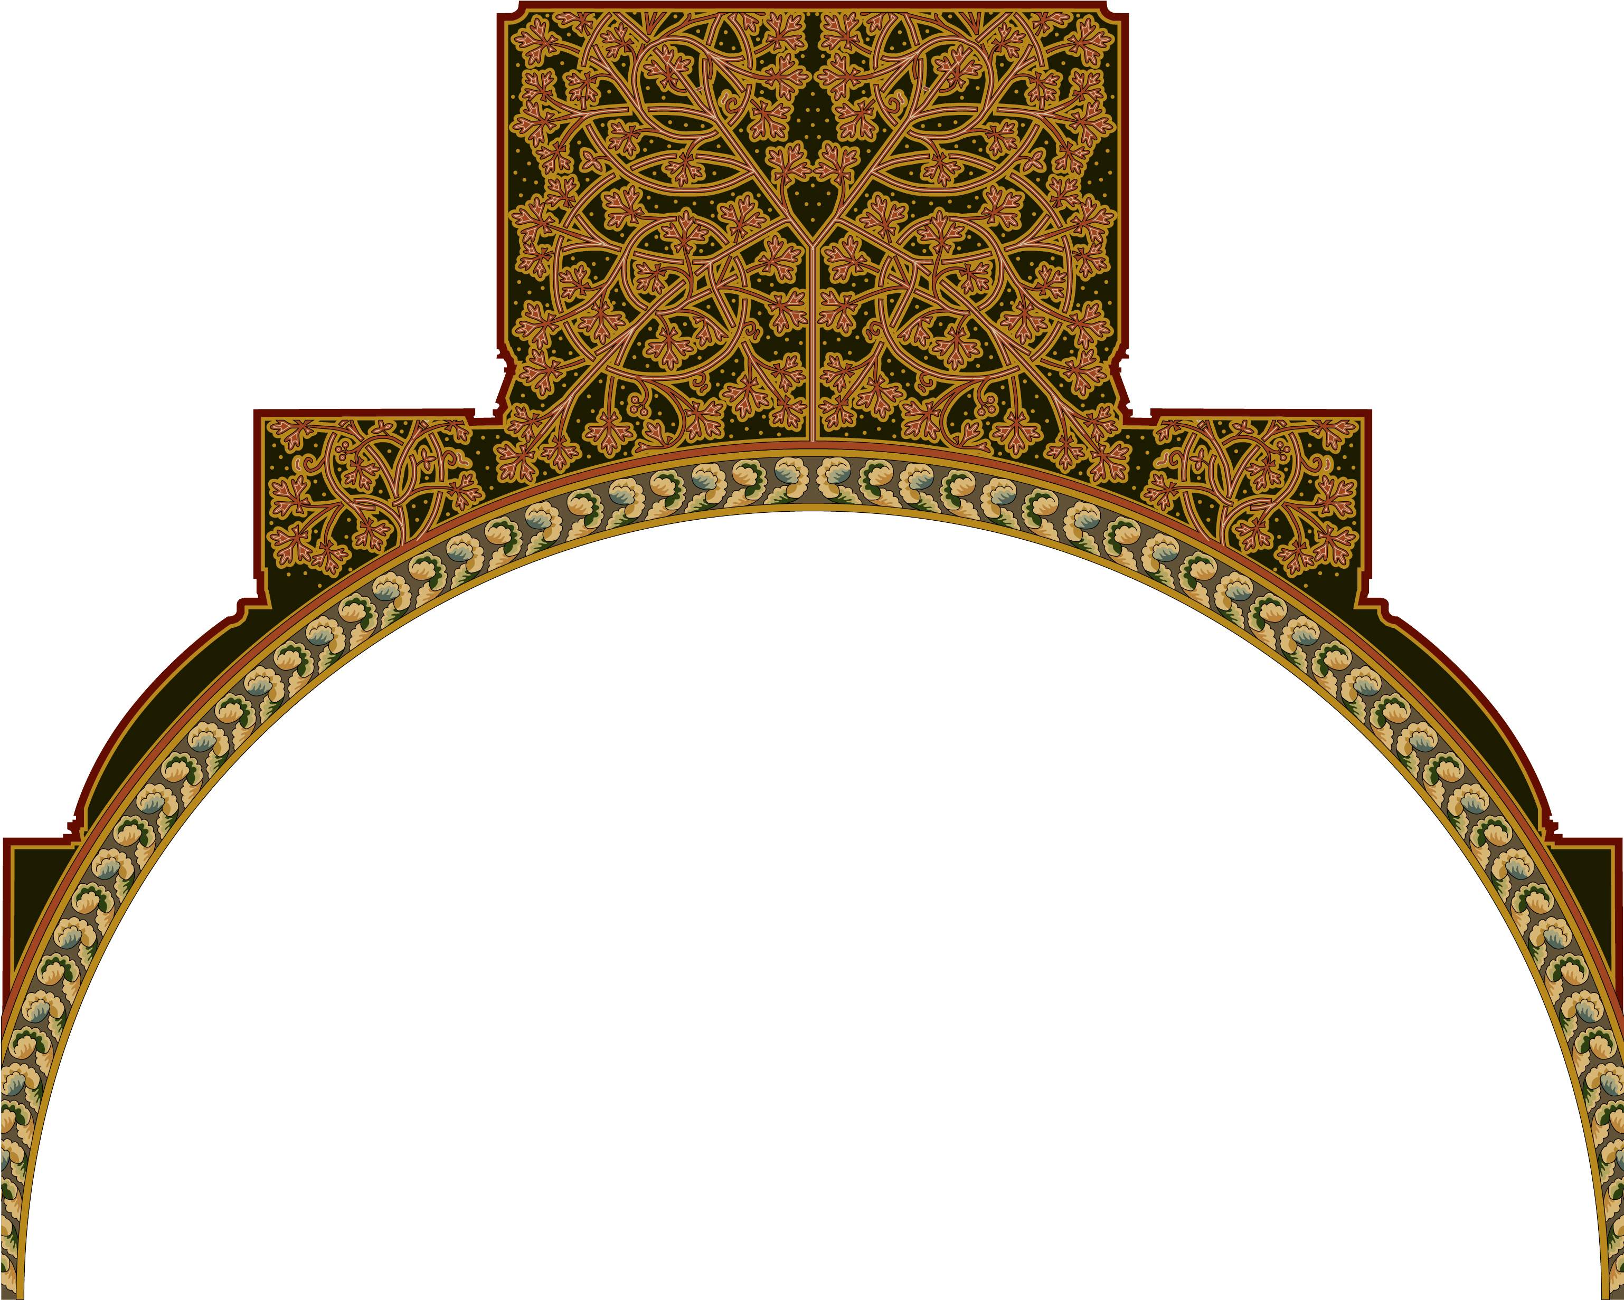
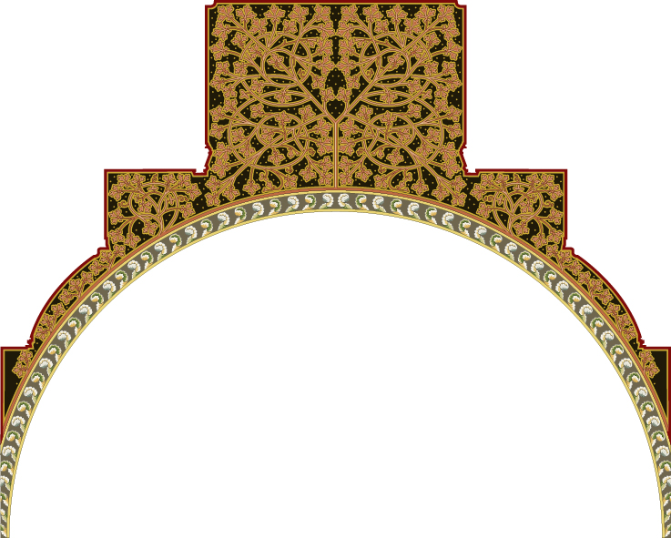
Solution no1 vs solution no2 comparison of the original and the texture with changed proportions
Solution 1
cutting off part of the texture from colourful section, same proportions
Solution 2
changing proportions of the texture, same composition
(differences in colours are not important in this case and are the result of attempts to find original colours of textures)

Slide 18
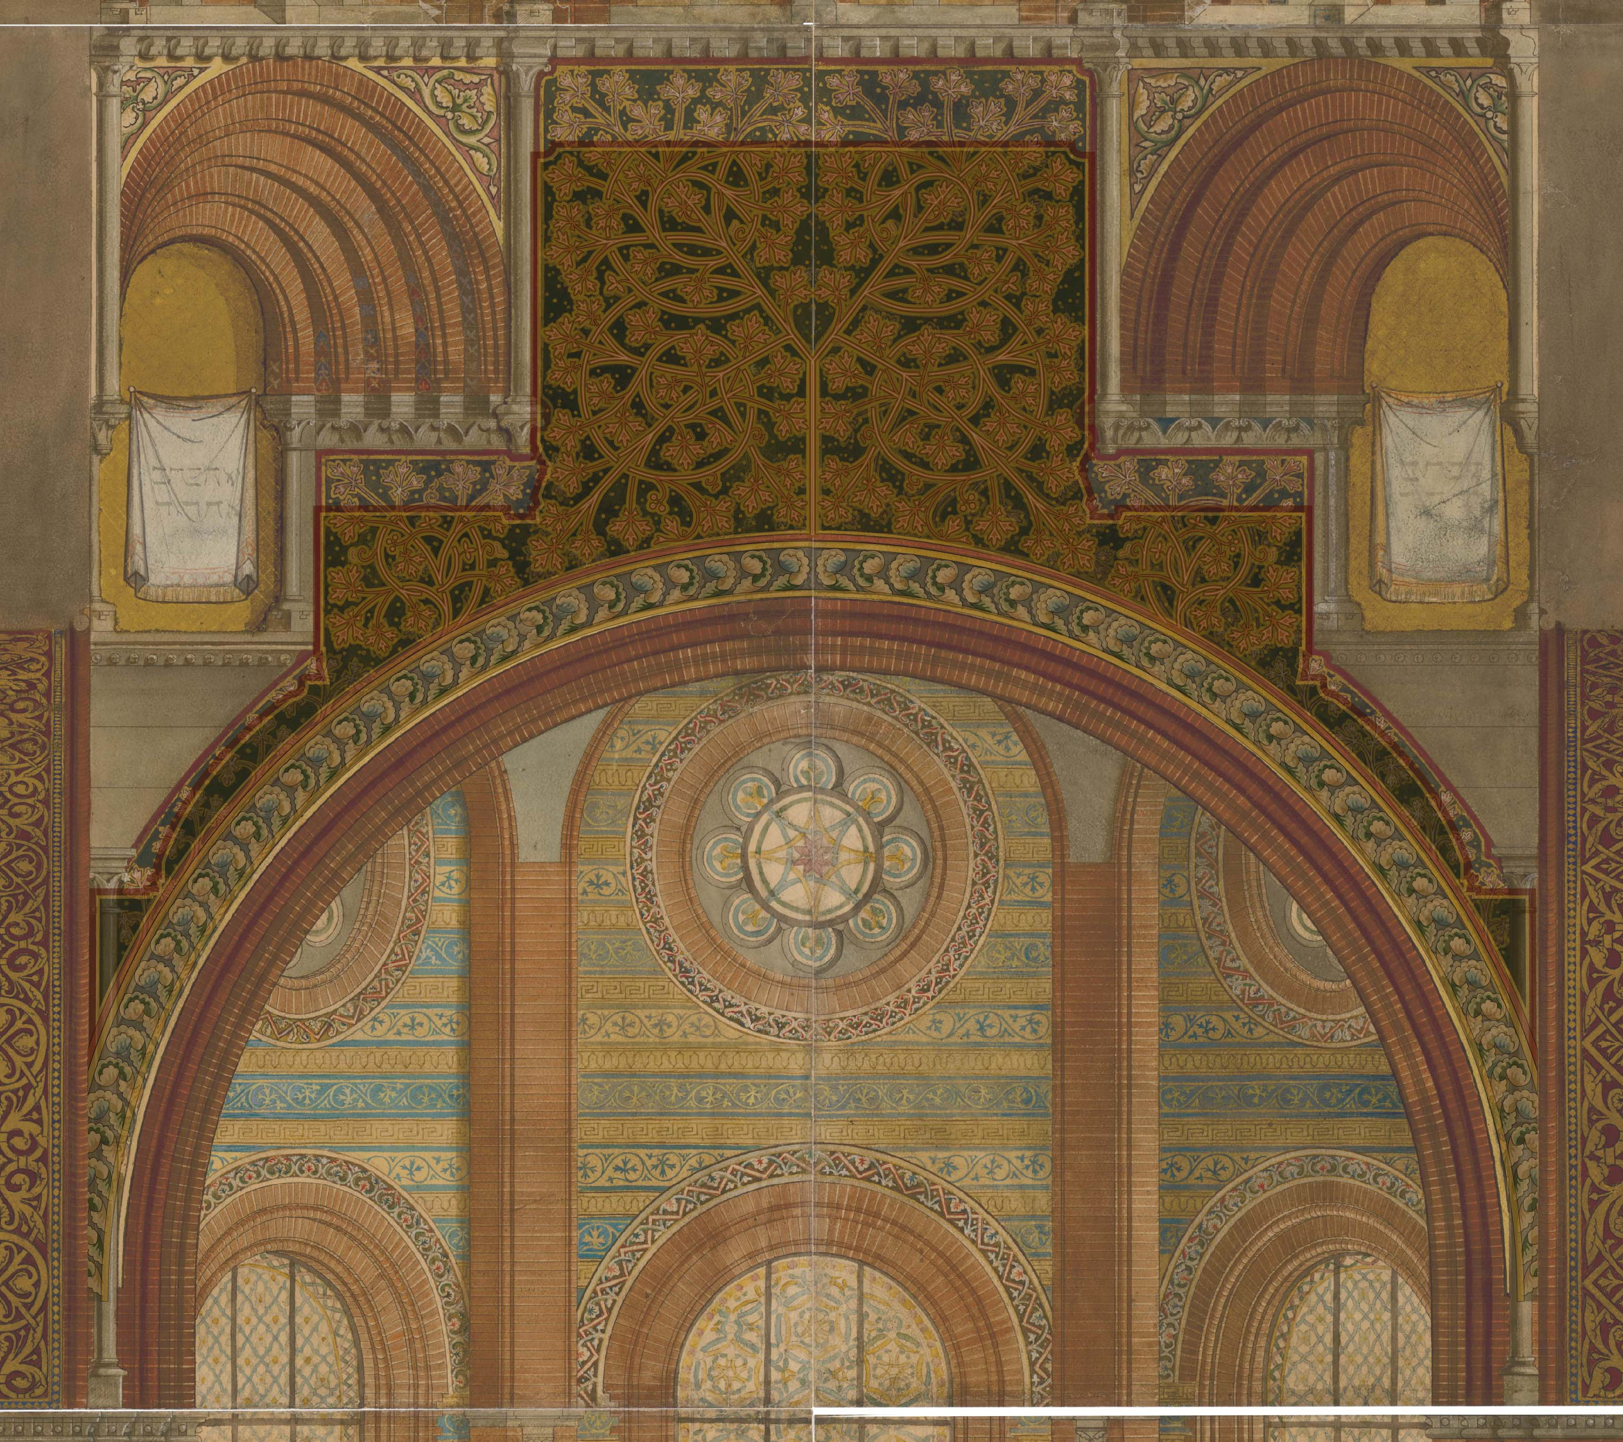
Redrawing texture (Solution 1) problems caused by differences between model and colourful section
problem: cutting off part of the pattern in the upper parts of the texture

Slide 19
Redrawing texture (Solution 1) problems caused by differences between model and colourful section
problem: flower pattern doesn’t match the shape under the pendentive (shape in model is much more irregular than in colourful section)

