Slide 1
Main textures reconstruction

Slide 2
Main textures
brick
copper
floor tiles
glass
granite
metal
plaster (varied colours)
sandstone
slate (rectangular, rhomboic)
wood (grained, plain, planks)

Slide 3
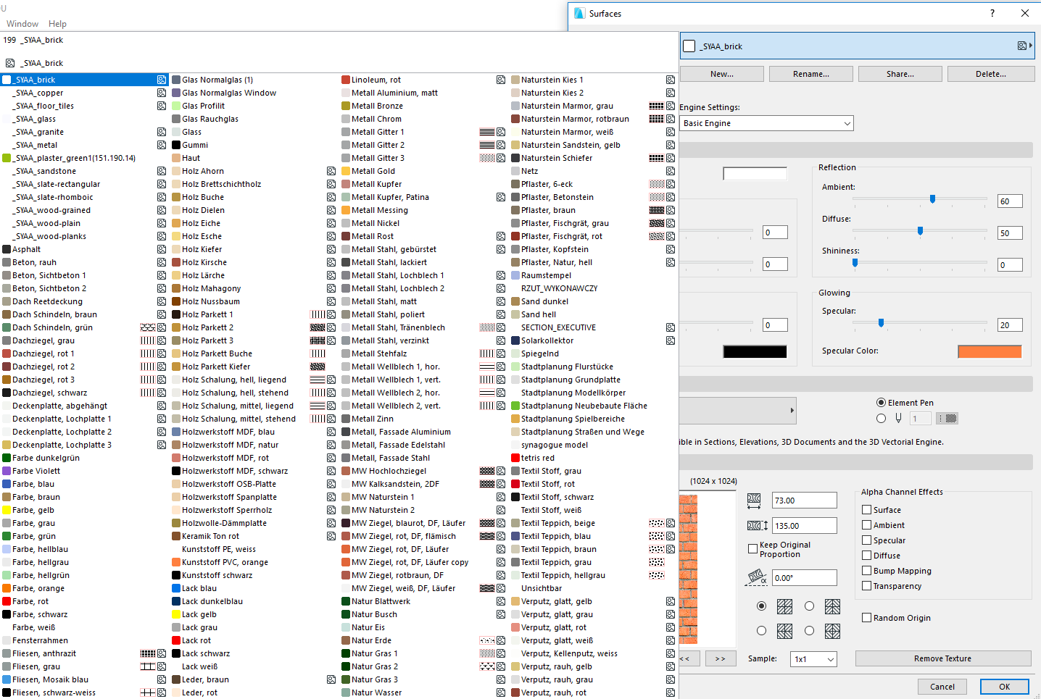
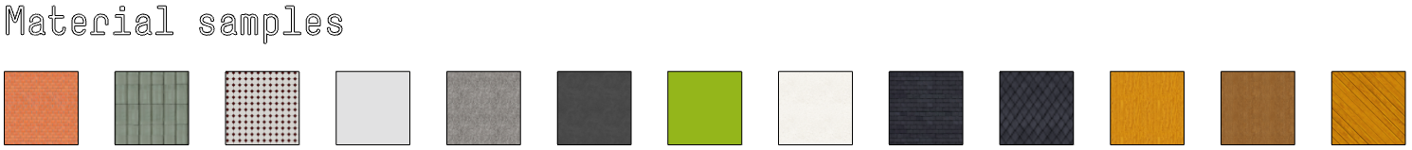
Main textures a pln. file with created materials uploaded on seafile
Importing materials:
place in your file a hotlink with .pln file that contains materials (even after deleting a file materials stay in material library)
or
copy material samples to your file

Slide 4
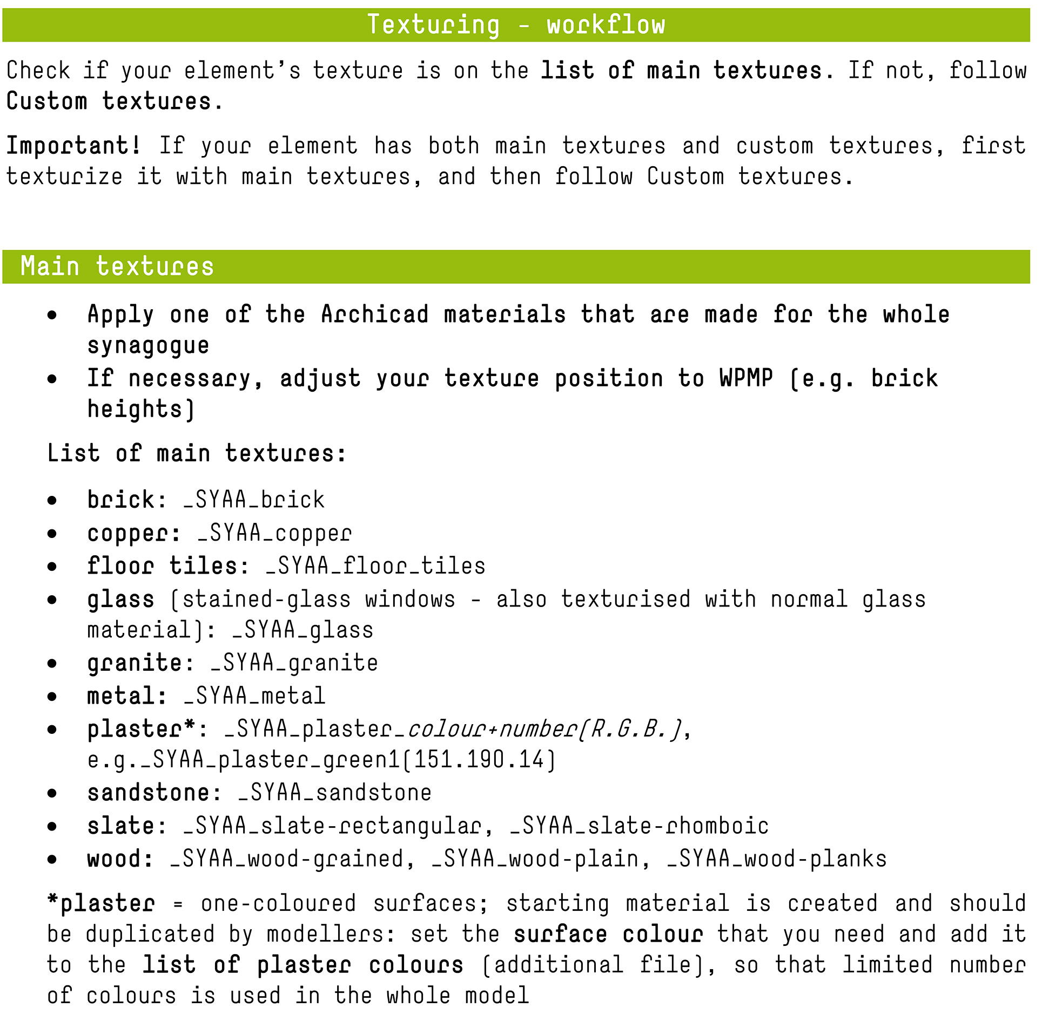
Main textures - workflow pdf with workflow uploaded on seafile

Slide 5
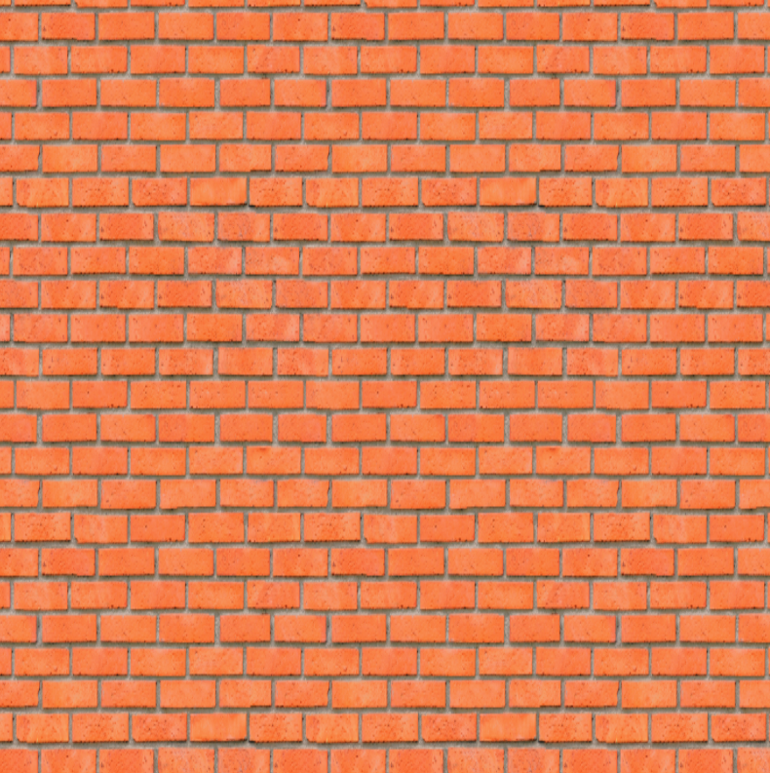
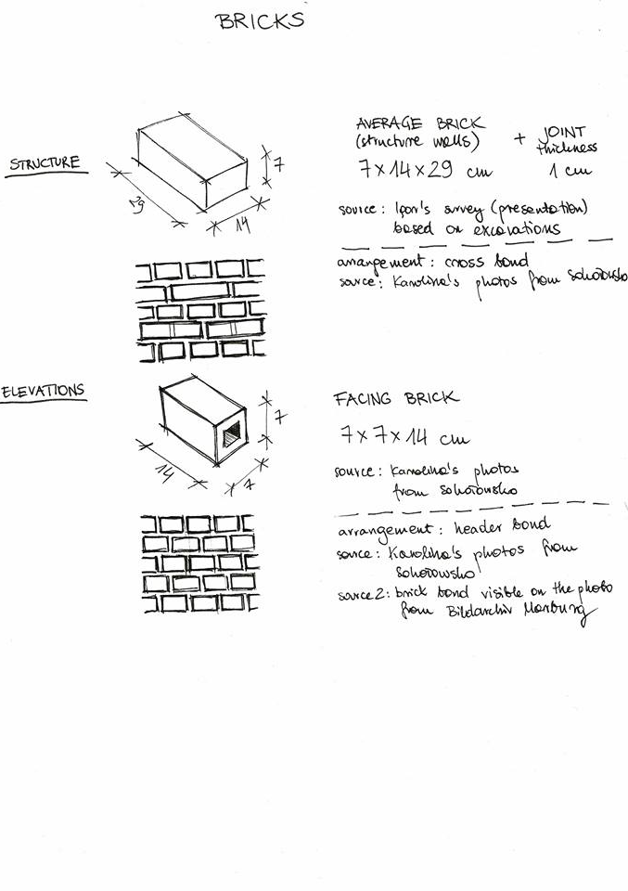
Walls - brick
_SYAA_brick

Slide 6
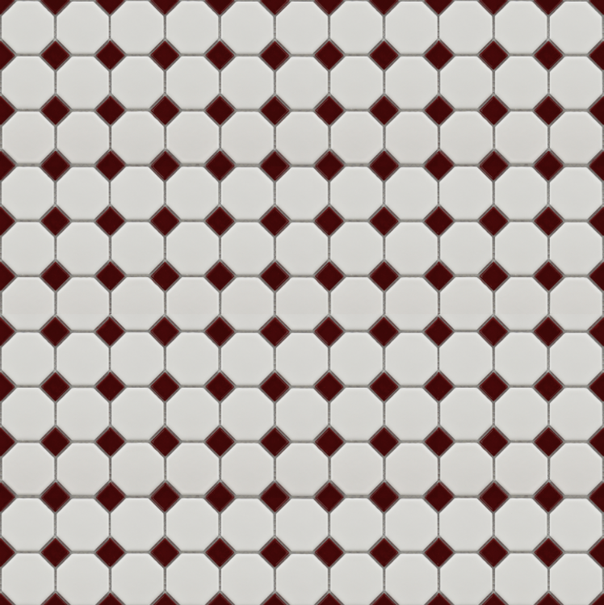
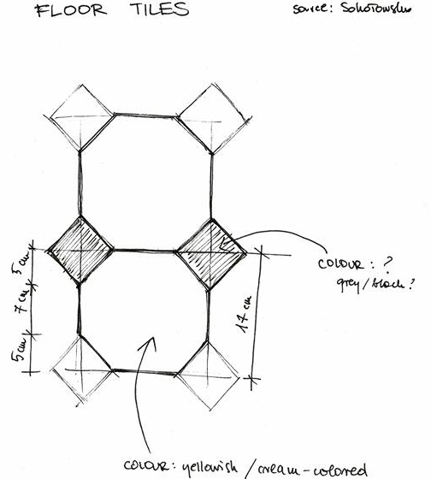
Floors – floor tiles
_SYAA_floor-tiles

Slide 7
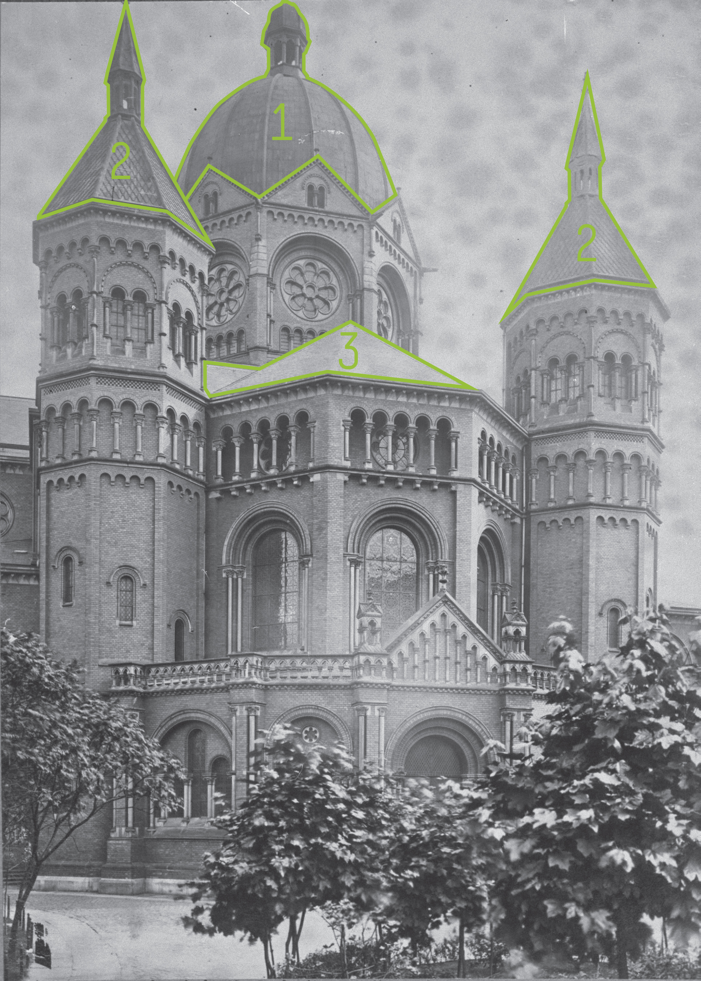
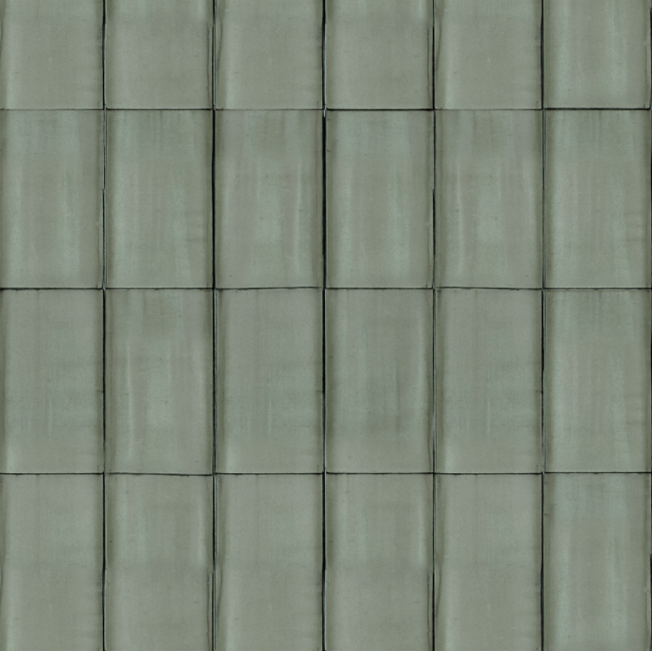
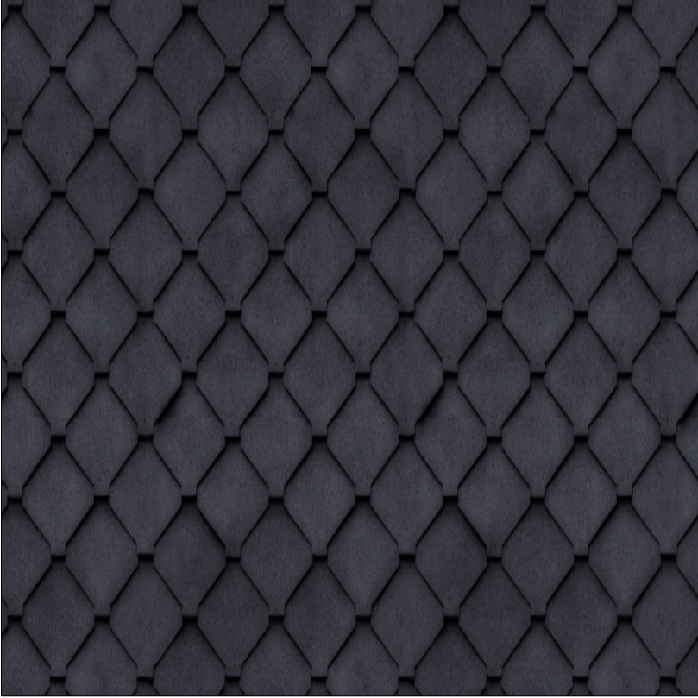
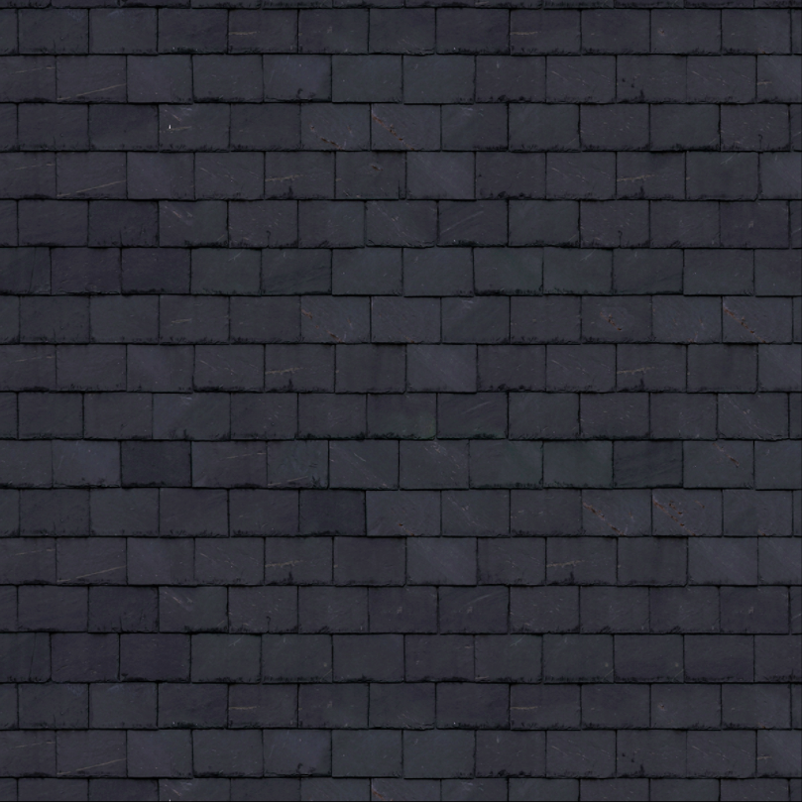
Roofs – copper, slate
_SYAA_copper(1), _SYAA_slate-rhomboic(2), _SYAA_slate-rectangular(3)
1
2
3

Slide 8
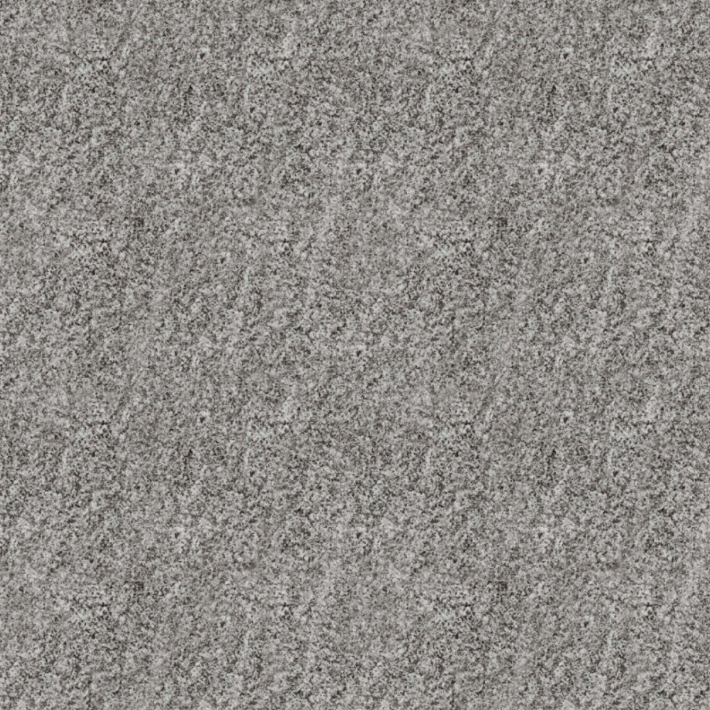
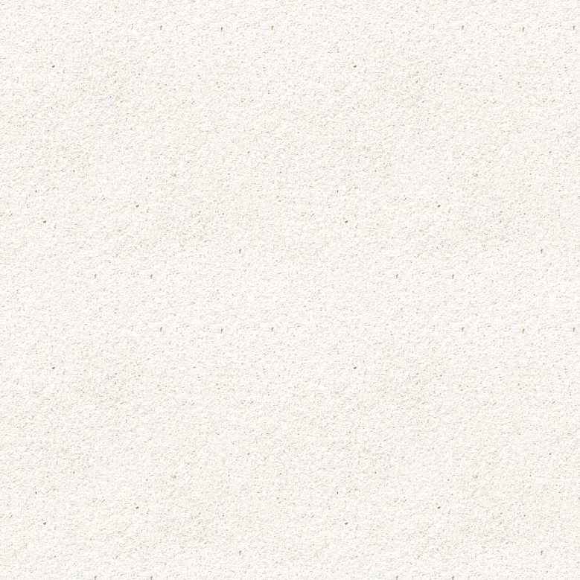
Stone elements
_SYAA_granite, _SYAA_sandstone

Slide 9
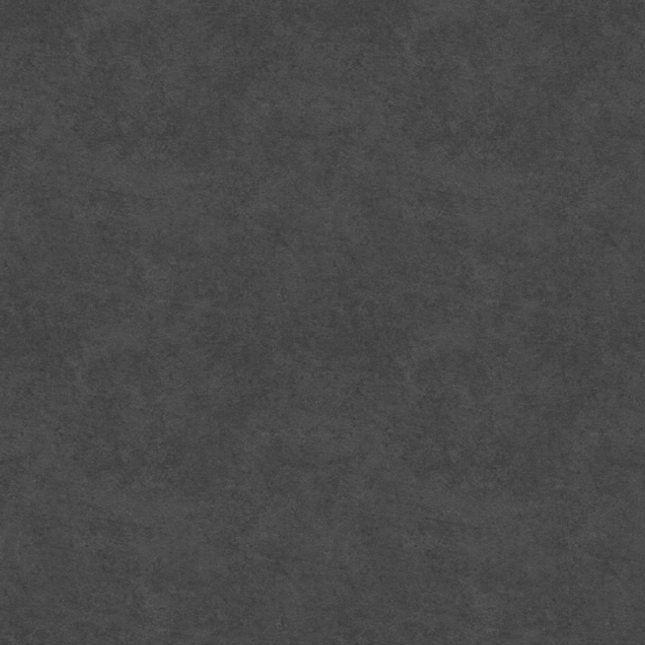
Metal elements
_SYAA_metal

Slide 10
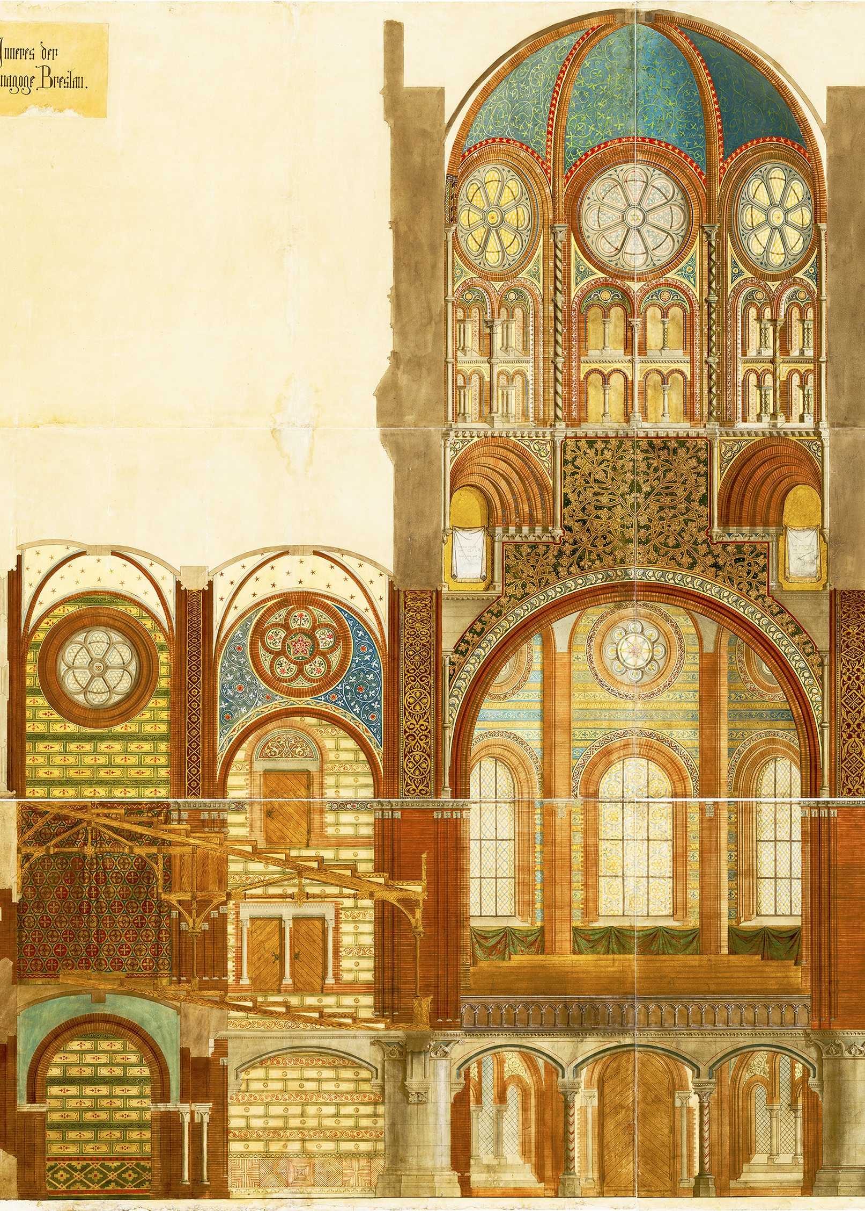
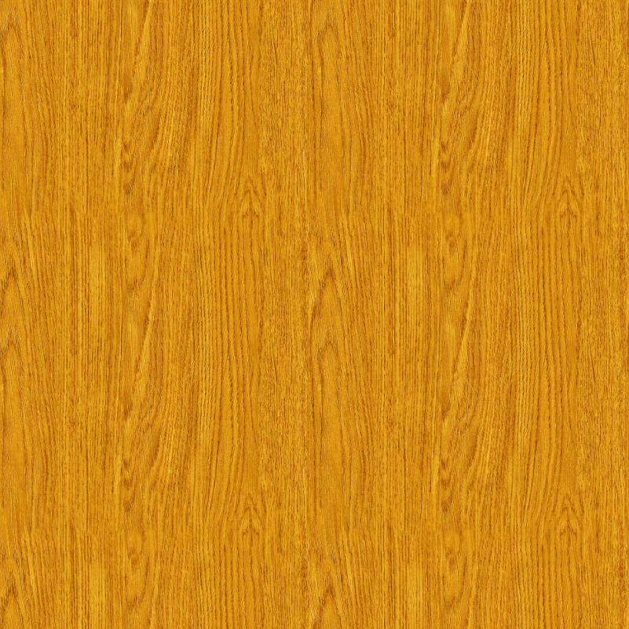
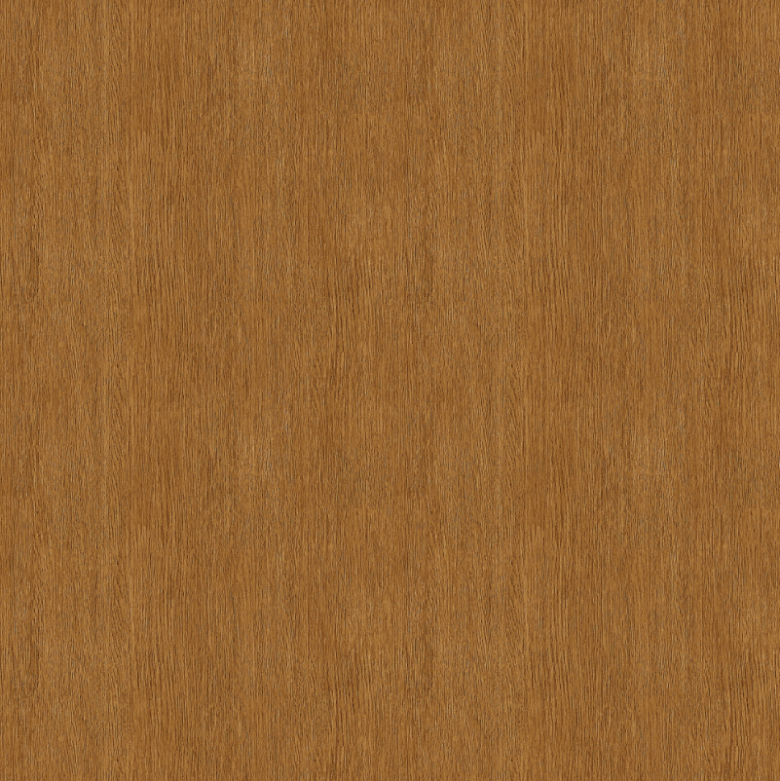
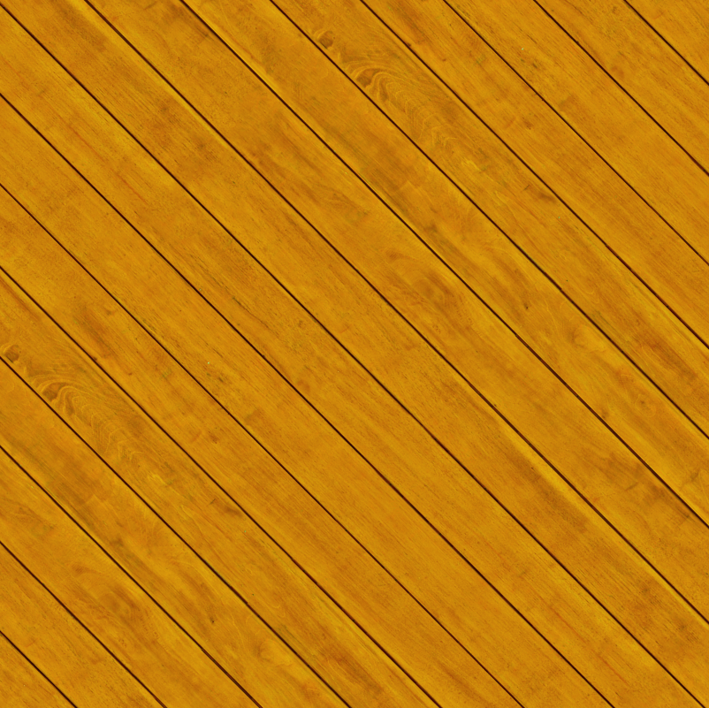
Wooden elements – interior
_SYAA_wood-grained(1), _SYAA_wood-plain(2), _SYAA_wood-planks(3)
1
2
3
3
1
2
3

Slide 11
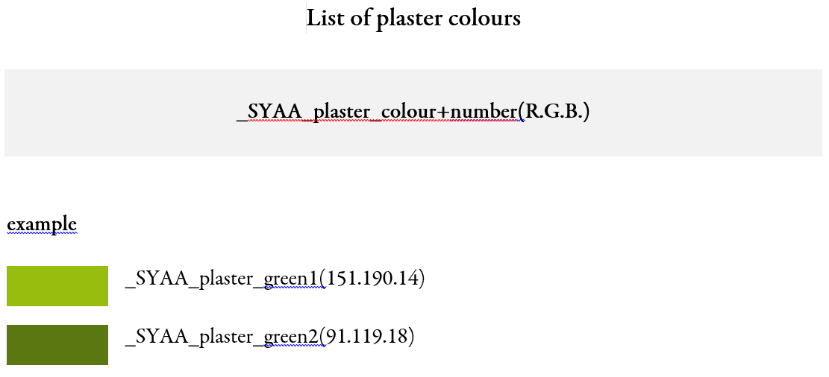
Plaster
_SYAA_plaster-colour+number(R.G.B.)
plaster = one-coloured surfaces; starting material is created and should be duplicated by modellers: set the surface colour that you need and add it to the list of plaster colours (List of plaster colours file on seafile), so that limited number of colours is used in the whole model

